Slide 1
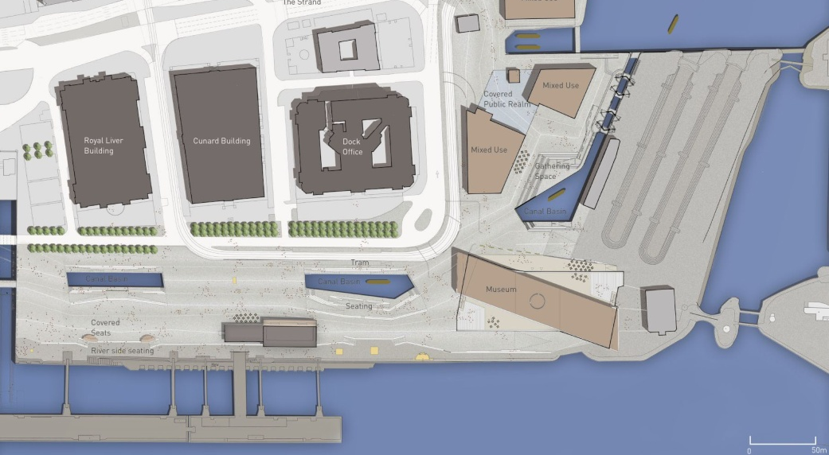
ECONOMIC BENEFITS OF RECREATIONAL WATERWAYS – UK EXPERIENCE
Martin Clarke – Director
Jacobs Engineering

Slide 2
My background
Civil engineer
Worked for British Waterways as project manager for new recreational canal works
Main focus was getting funding from UK government and EU because of economic benefits
Now a consultant working for British Waterways and UK government
PIANC British National Committee

Slide 3
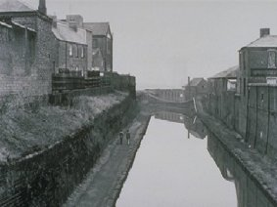
Decline of commercial canals
Decline following transfer to rail network
By 1960’s many canals closed or derelict
Recreational use continued
Strong voluntary sector campaigned for restoration
1980’s saw focus on urban renewal, eg London docklands

Slide 4
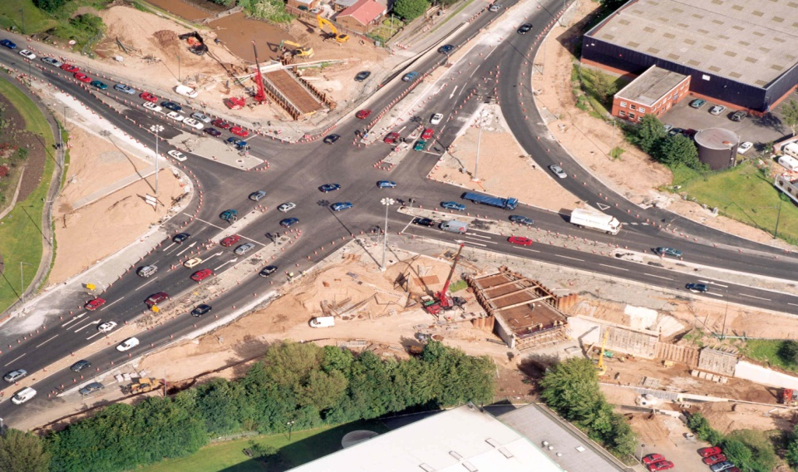
Delivery of Restoration
By 2002 in North West of England:
Huddersfield Canal
Rochdale Canal
Ribble Link
Anderton Boat Lift
Total value over £80M

Slide 5
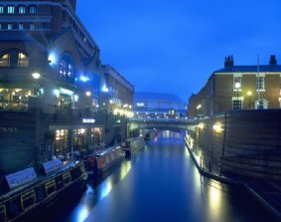
Birmingham – more canals than Venice !

Slide 6
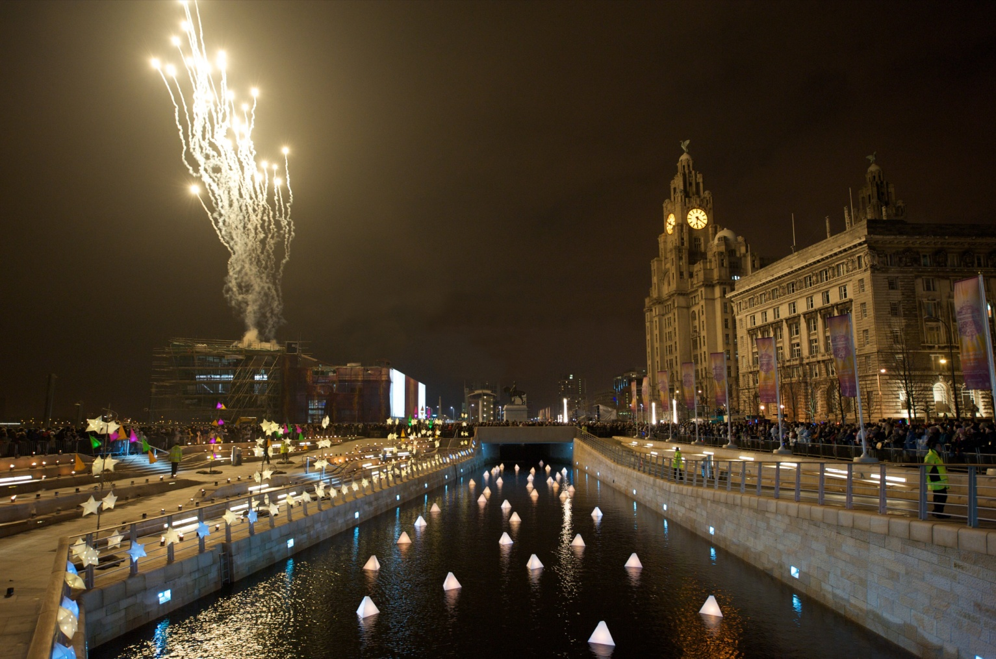
LIVERPOOL CANAL LINK –
challenges of capturing benefits

Slide 7
Summary of Annual Benefits
200,000 extra visitors to waterfront spending £1.9m
4,500 boat movements including private, hire, trips, restaurants
£2.2m extra spend on boating related activities
187 person years temporary construction work
173 net additional local jobs
£3.3m net additional gross value added
Increase in property prices through canal corridor up to 20%
Above based on study by Amion, though likely to be increased
The above is why we got public funding

Slide 8
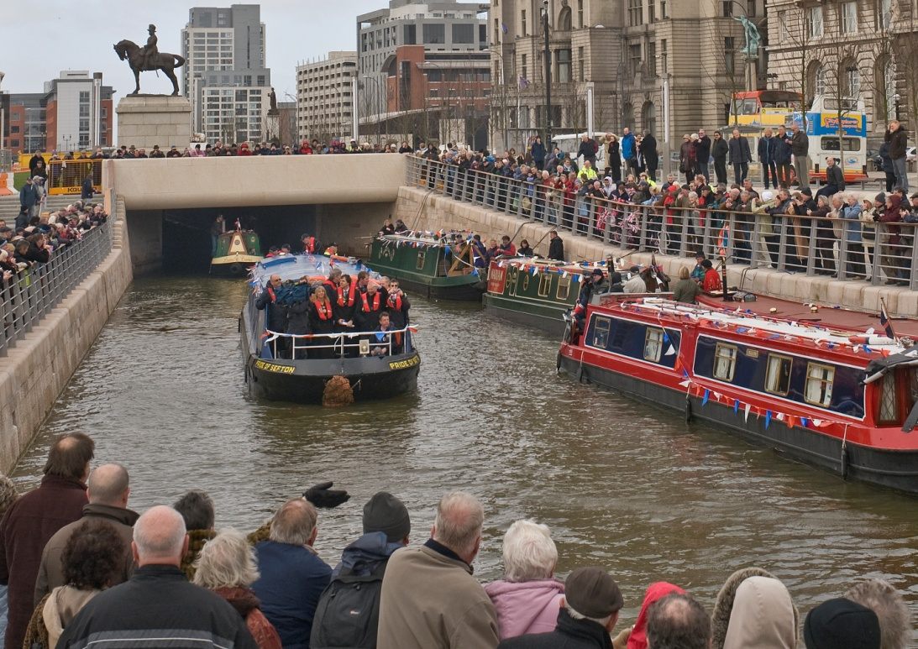
Benefits
British waterways receives no money, they have a maintenance liability
Benefits are all indirect – private businesses, local taxes, local people
How can we measure this properly ?

Slide 9
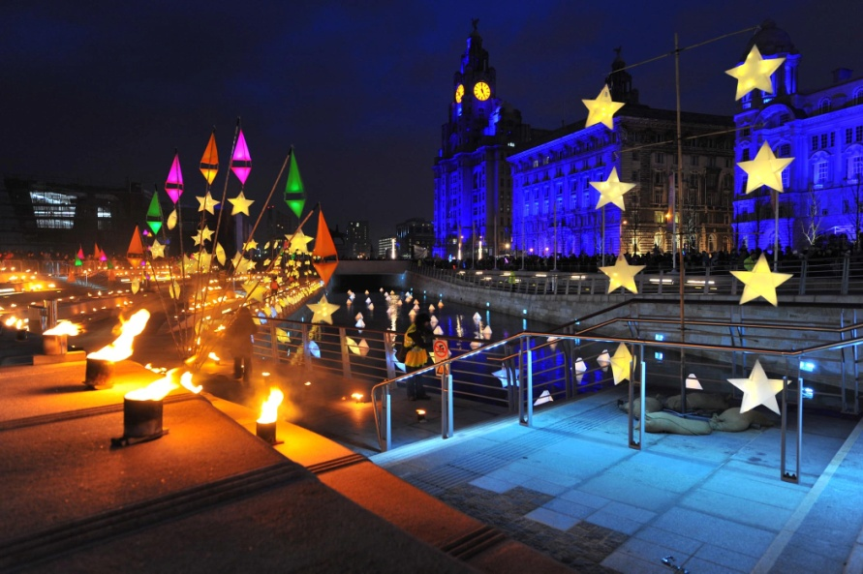
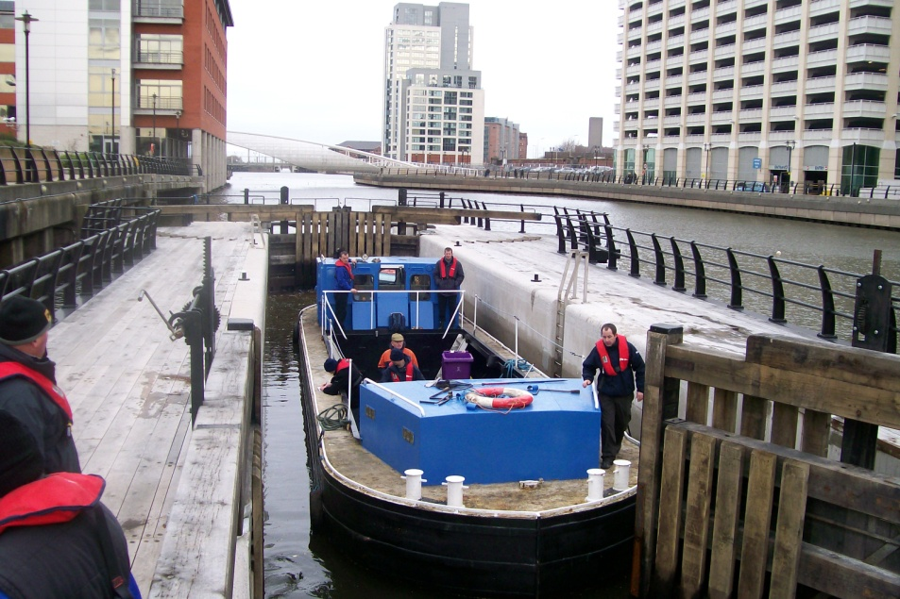
Benefits valuation framework
Jacobs research for UK government
Well being ( welfare ) benefits – what would people pay, health
Economic benefits – jobs, spend
Only measures benefits of making changes ( marginal benefits )

Slide 10
Other social benefits
How communities think about their city and their local area
How they behave and their attitude to society
What are the benefits ?
Anti-social behaviour and crime reduction
Increased social inclusion
Areas more attractive to visit, live in and work in

Slide 11
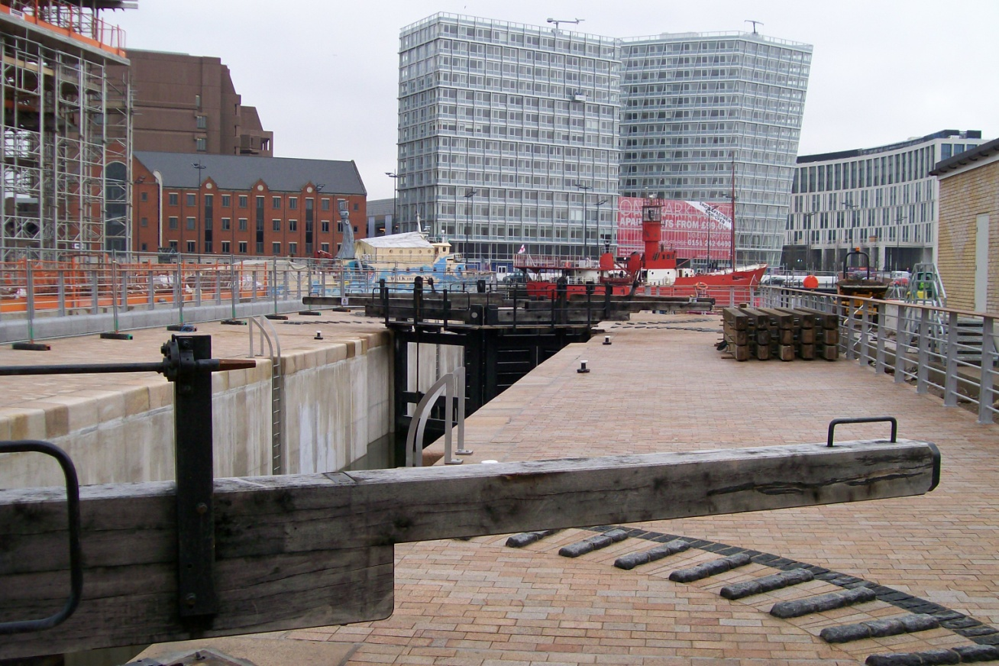
Summary
UK canals have been transformed from declining commercial waterways
They are now very successful recreational canals
They have had a direct and indirect influence on local areas
Measuring benefits is very difficult – there is always a debate !

Slide 12
References
Benefits valuation framework - www.iwac.org.uk/reports
PIANC RecCom working groups – www.pianc.org/reccomactivewg.asp
My e-mail - martin.clarke@jacobs.com

