Slide 1
UNECE initiative on Education on Standardization
Lorenza Jachia
Secretary, Working Party on Regulatory Cooperation and Standardization Policies
Milan, 8 January, 2015
Notes:
This is a sample Title Slide with Picture ideal for including a dark picture with a brief title and subtitle.

Slide 2
UNECE: United Nations Economic Commission for Europe
Large and diverse membership (56 members)
Large mandate encompassing Trade, Environrment, Transport, Sustainable Energy, Forestry, Housing and Land Management, Statistics, etc.
UNECE helps implement the Sustainable Development Goals by translating global goals into norms, standards and conventions, building capacity and engaging in partnerships with the private sector, the academia, and civil society
“UNECE’s achievements have made it a go-to source for improving global public goods and services, with more than 100 countries beyond the UNECE region benefiting from its work” (UN Secretary-General Ban Ki-moon)

Slide 3
UNECE Working Party on: Regulatory cooperation & stds policies
What we are:
Intergovernmental body
Participation by: authorities, regional & int’l org, standards-setting bodies, business, certification bodies, test houses, civil society
From all UN Member States
1970 – 2015: 45+ years
Our mandate:
☑ Standardization ☑ Technical regulations ☑ Conformity assessment ☑ Accreditation ☑ Metrology ☑ Market surveillance ☑ Risk Management ☑ Education on standards and standards related issues
Our activities
Develop and share info & best practice
Capacity-building (trainings and awareness-raising events)
Develop and maintain a set of recommendations
Implement a set of initiatives on specific industrial sectors
Notes:
Bruegel lived in 16th century

Slide 4
Recent UNECE WP. 6 events
December 2015 – WSC workshop on conformity assessment (co-organized by UNECE, ISO, IEC and ITU)
November 2015 – UNECE – ISO – IEC Workshop on «Using and referencing international standards to support public policy»
March 2015: Standards forDisaster Risk Reduction (event of the World Conference for Disaster Risk Reduction, Sendai, Japan)

Slide 5
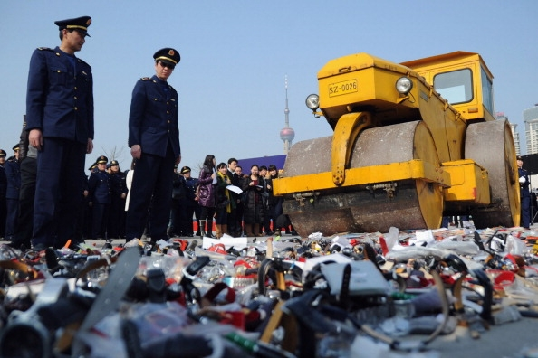
Why are standards and regulations important?
Deep regulatory fragmentation
Risks from dangerous products and facilities on the rise
Mounting costs for the testing & certification of products & production processes
Staggering rates of non-conformity on the markets
Proliferation of low quality and counterfeit goods not just for consumer products, but also for: pharma, high-tech equipment used in plants and factories, electrotechnical consumers goods….

Slide 6
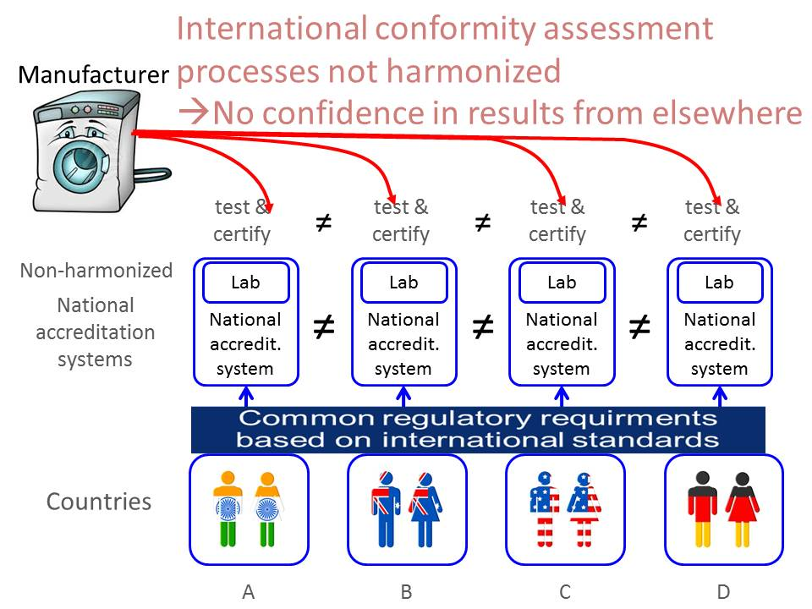
Lessons learnt: Advantages from regulatory cooperation: pre-market
Challenge for regulators is to go beyond harmonization of regulations and standards
Towards the international harmonization of regulatory systems, including through the increased use of conformity assessment schemes
Avoid duplication of testing and enhancing the competitiveness of the industry

Slide 7
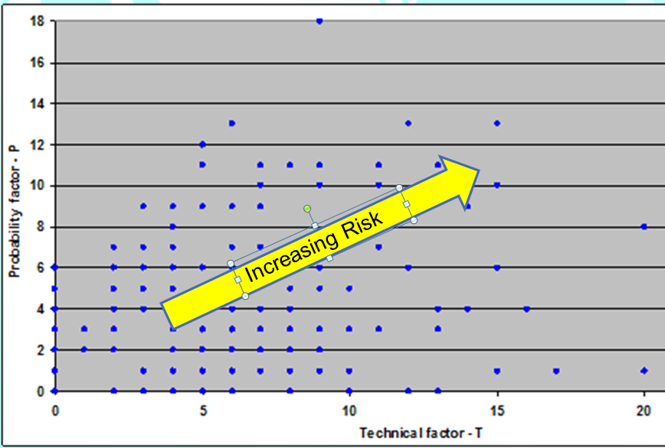
Lessons learnt: Cooperation among regulators: post-market dimension
Standards
help define “how dangerous” is the product/service/equipment
≠
Conformity assessment helps
control for probability of non-compliance

Slide 8
How can academia help?
Research on: impact of regulatory fragmentation on growth, innovation, safety for consumers and businesses
Raise awareness among the young of the importance of standards for sustainable development
Equip graduates with tools that will enable them to tackle technical, and organizational issues with a pragmatic, hands-on and holistic approach
Strengthen exchanges with the UN through internships, joint research projects, field visits for classes…

Slide 9
What we’ve achieved so far:
1970
Adoption of Recommendation I
Governments encouraged to include standardization in the curricula of educational institutions
2011
More than 40 years had passed
Few educational institutions have included standards in their curriculum
Very different educational approaches internationally
2012
Workshop on «Education on Standards Related issues»
Revision of Recommendation I adopted by Member States (more on that later)
Ad Hoc Group of Experts on Education on Standards related issues (STARTed) set up & held 1st meeting
Development of a model curriculum for teaching standards-related issues in Universities
2013-2014-2015
Annual meetings of the STARTed Group
Development of 4 of the 15 modules in the curriculum
Partnership with the Russian Academy for Standardisation, Metrology and Certification
Partnership with EURAS - European Academy for Standardisation
Development of a repository of education-related materials http://www.unece.org/trade/wp6/educationonstandardization.html

Slide 10
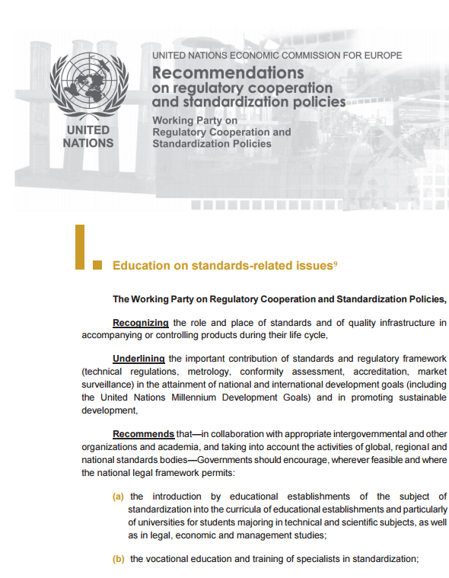
Recommendation I
Governments should encourage:
the introduction of the subject of standardization into the curricula of educational establishments and particularly of universities for students majoring in technical & scientific & legal & economic & management studies;
the vocational education and training of specialists in standardization;
the enhancement of awareness-raising activities targeted to the business community and regulatory authorities;
the further study of standardization issues to ensure that standardization and regulatory regimes contribute to legitimate concerns of society

Slide 11
Model educational programme on standardization
Should ideally cover, in a logical order, the minimum set of issues that a programme on standardization should contain to give a student a general understanding of the major standardization, regulatory and related issues relevant to business and regulatory and administrative authorities.
For implementation by general university level academic programmes (bachelor and master) in economics, business administration and law, rather than to specialized training in standardization.
While the model programme aims at establishing a core curriculum, the specific set of issues and the time allocated to each area would clearly have to be tailored to the needs of a specific educational institution and programme.
Developed in consultation with a group of experts from educational institutions from Europe and CIS region

Slide 12
Curriculum – 15 modules
1. Standardization basics
2. Benefits of standardization for society
3. Standardization and companies
National legal and institutional framework
Regulatory policies and related institutional mechanisms
6. Managing risks through standards, regulations and regulatory impact assessments (RIAs)
7. Metrology
8. Conformity assessment
9. Market surveillance
10. Management system standards
11. International standardization
12. International trade, standards and regulations
Standardization of information requirements and supply chains
A practical exercise: Standardization within a company
15. Policy issues and challenges in standardization

Slide 13
Proposed cooperation with LERU
UNECE unique mandate: standardization, metrology, technical regulations, conformity assessment, market surveillance and risk management.
Other institutions focus on only one area UNECE promotes a holistic understanding and approach
Opportunities for:
Joint studies and research projects
Joint development of online or offline teaching modules
Internships
Regular/ad hoc interventions in classes or courses by UNECE staff
Advice/contributions for the development of courses/curricula on standards-related issues by UNECE staff

Slide 14
Thank you
Lorenza Jachia
Secretary, Working Party on Regulatory Cooperation and Standardization Policies (WP.)
Lorenza.jachia@unece.org

