Slide 1
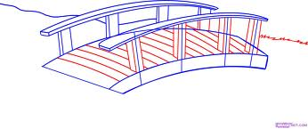
Purpose of the UNECE advisory support –identifying ways to unlock the potential of sustainable forest management to better meet Green Economy principles and objectives. Need to conduct gap analysis between forestry potential and green economy principles
Green
economy/
Sustainable
development
objectives
and priorities
Sustainable
forest
management
potential
Identify actions to help bridge the gap

Slide 2
Process of the initiative to develop an analysis- scoping paper on linkages between forestry and the green economy
Outcome: Analysis- scoping paper and process documentation
Communication and participation throughout
(1 participatory workshop) Drafting and review of analysis paper. Putting together the analysis in coherent paper.
(3 participatory regional workshops) Analysis –Analysis and data gathering with stakeholder to identify gaps and potential linkages
(National Workshop) Preparing and planning. National workshop, understanding principles, skills and methods for participatory analysis

Slide 3
Why do we need further gap analysis on matching sustainable forest management to green economy principles?
Forestry not fulfilling its full potential in delivering green economy principles. Need to understand the local realities before we can make effective recommendations.
Forestry not fulfilling its full potential in delivering green economy principles;
generation of forestry related jobs/improved livelihoods
increased sustainable production of ‘green’ energy and materials, including wood energy
full engagement of local stakeholders, private sector and inter-sectoral cooperation
Need to raise the profile of forestry to show that it ticks all the green economy principles; social, economic, carbon/climate and ecological

Slide 4
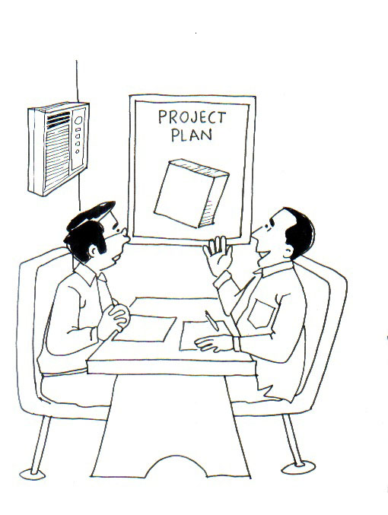
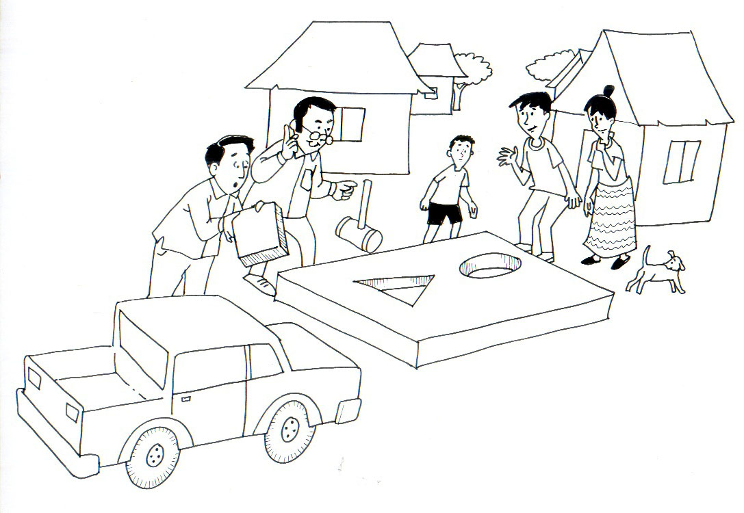
Why do we need to engage stakeholders in local workshops to help develop the gap analysis between forestry and green economy principles?
Why didn’t they ask us our opinions first
Nice plan boss.
This is the green economy action plan our country needs, now lets implement.
The plan doesn’t fit the realities on the ground, what do we do now?
Green economy plan
Planning based on office assumption
Stakeholder realities

Slide 5
Group work: Matching tools to purpose and stakeholder group.
Which tools and methods can be used for which topics and which stakeholder groups in Armenia in the regional analysis
?
Which participatory method is best for which purpose and stakeholder groups?
The purpose, circumstance and stakeholder group
If the key doesn’t fit, try another key!
Notes:
5
Context

Slide 6
Analysis of barriers to maximising sustainable production and consumption of forest products?
Key gaps? | Which stakeholders should be engaged? | Which participatory methods should be used?
Notes:
BIG SHEET: Prepare on 3 big flip charts

Slide 7
Analysis of barriers to promoting the development of sustainable wood energy as a environmentally friendly, socially and economically viable energy source?
Key gaps? | Which stakeholders should be engaged? | Which participatory methods should be used?

Slide 8
Analysis of barriers to improving forest based livelihoods and jobs, especially in making forestry attractive for small, medium and large scale private investment?
Key gaps? | Which stakeholders should be engaged? | Which methods – should be used for participatory analysis?

Slide 9
Presentation of analysis for peer review. Think about the following criteria during the presentation.
Key gaps? Are the topics relevant to green economy principles and the gaps identified in Uzbekistan?
Key stakeholders? Are the most affected stakeholders identified?
Right methods for purpose? Are the methods suggested appropriate for that gap analysis?
How participatory? Is what is proposed full participation or only superficial consultation?

Slide 10
Rapid training evaluation
Procedure: One ‘x’ per person per triangle section. Do not be influenced by others.
Scores
1. Very poor, 2. Poor, 3. Satisfactory
4. Good, 5. Excellent
A. Enhanced understanding of application of Green Economy principles to Kazakhstan forestry context
B. Enhanced understanding of effective forest strategy development.
1
2
F. Overall training workshop approach and facilitation
3
C. Enhanced understanding of relevant forest data gathering and management
4
5
1
2
3
4
5
5
4
3
2
E. Enhanced understanding participatory methods.
D. Enhanced understanding of relevant wood energy strategies
1
Notes:
BIG SHEET GUIDE: Prepare on 3 flip chart size.

