Slide 1
Agenda for Day 3
Morning.
Presentation by the country.
Rotating the responsible teams.
III. Forest policy development continued.
Presentation on effective forest policy formulation/drafting.
Exercise. Drafting a coherent policy statement for enhancing sustainable forest management for greener economies.
Presentation of statements for critical peer review.

Slide 2
Training flow and structure – where are we?
Components of the training | Content-topics of the training
Intro to the training SFM and green economy principles
Review and analysis skills and methods. Spotlight on data gathering and analysis
Spotlight on wood energy Policy priority negotiation Policy drafting and review
Planning the process and methods for forestry plan/strategy for the green economy development. Training evaluation
Preliminaries and principles
Review and analysis
Policy development
Outcome: Improved understanding and skills

Slide 3
Function and principles of an effective forest policy
What is a forest policy?
It is a non-legally binding strategic level guidance document to provide direction for forestry in the medium/long term.
Forest policy should incorporate the findings from exhaustive analysis and the priorities negotiated by all key relevant stakeholders.
What key principles should be applied when drafting and reviewing a forest policy?
Neutrality in drafting, incorporating analysis and balancing stakeholder interests.
Actors involved must link local, national( including cross-sectoral) and international levels and commitments
Must be realistic and achievable within existing or planned/expected resources.

Slide 4
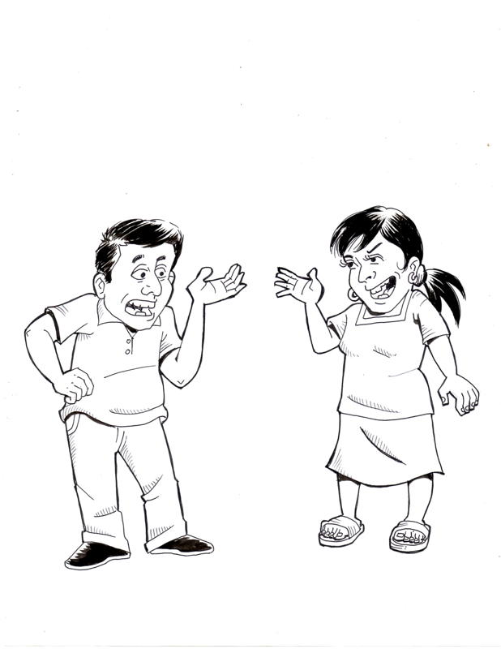
Policy drafting – keeping it real!
The forest policy is very good, the country just does not have the resources to implement it, that is the problem.
Policies should be fit the resources available in the country, if not it is simply a bad forest policy.
How many forest policies in transition countries are actually implementable with the resources available?
Notes:
4

Slide 5
Str drafting – who is directly involved?
Advisory committee – senior level cross sectoral relevant ministerial and departmental senior representatives from key relevant ministries and departments E.g. forestry, agriculture, trade, energy, mining, statistics
Multi-stakeholder reviews.
E.g. focus group discussions with stakeholder groups, or multi-stakeholder workshops using participatory review methodologies
Core drafting team. Maybe 4-6 people; E.g. Forest policy experts, policy researchers and editors
Intermittent advisors. E.g. Thematic experts on forest management, tenure, private sector engagement

Slide 6
Form of an effective forest policy
The form of forest policy changes from country to country to reflect the context – however some generic principles of effective forest policy include:
Forward looking - (e.g. 25-100 years), with clear vision of goal - ‘the destination’, and broad strategies how to get there - ‘the journey’.
Logically structured – with clear flow and coherent components directly linking to goal and avoiding overlap or contradictions.
User friendly and concise - written in a simple and clear language, concise (e.g. 20-50 pages maximum) and well laid out to make it easy to understand.
Specific as possible in terminology used - to ensure common understanding avoiding different interpretations.

Slide 7
Generic policy structure – details provided in the handout
Title, table of contents, definitions Preamble
1.Brief context analysis – TRENDS, CHALLENGES AND OPPORTUNITIES
2. Description of the expected long term vision/impact of the policy and time frame(e.g. 25 – 100 years) – THE DESTINATION
3. Overall purpose – HOW TO GET THERE? THE BROAD PRINCIPLES AND STRATEGY IT WILL USE TO GET TO THE DESTINATION
4. Component objectives - THE THEMATIC OR CROSS CUTTING BUILDING BLOCKS OF THE STRATEGY
5. Courses of action - ELABORATION OF ACTION STEPS UNDER EACH COMPONENT OBJECTIVE
6. Forestry institutional reform, funding and other issues related to implementation - WHO AND WHAT IS REQUIRED IN TERMS OF INSTITUTIONAL CAPACITIES, LIST ACTORS ROLES AND RESOURCES TO IMPLEMENT THE COURSES OF ACTION.
7. Guidance on rules, incentives and penalties - WHAT ARE THE ‘CARROTS AND STICKS’ – INCENTIVES AND DISINCENTIVES THAT WILL BE AVAILABLE FOR FOREST STAKEHOLDERS. Note: Most flourishing forest sectors have policies focussing on positive incentives making forestry attractive and competitive rather than excessive focus on what is not allowed, which tend to discourage investment and even result in increased illegality.

Slide 8
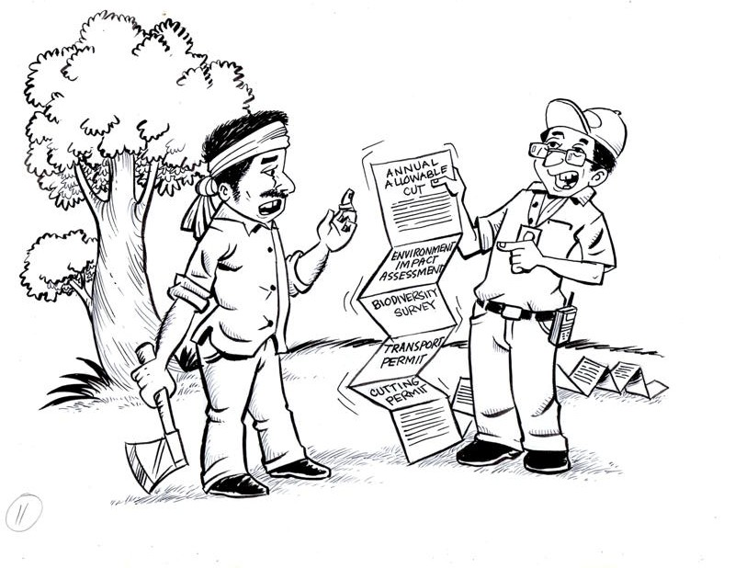
Forest policy and resultant regulations – excessive restrictions and complexity can even encourage illegality
I think it would be much easier if I just offer this forest guard a bribe.
You are required to fill out all these forms before you are allowed to harvest those trees.
When will he offer me a bribe?
Regulations/procedures that are overly restrictive can be counterproductive – effective policies should promote user friendly procedures that make legal and sustainable use more attractive.
Notes:
The module we are on will be highlighted.

Slide 9
Canada’s forest strategy – 15 pages long – developed through inclusive participatory process also
Vision To be the best in the world in sustainable forest management and a global leader in forest sector innovation Commitment to sustainable forest management.
National priorities Forest sector transformation – need to continually innovate and broaden the range of forest related products and services, increase efficiency and engagement with local people. Climate change –strengthen role of forests in mitigation and adaptation
Goals and desired outcomes Goals: A) Ensure a prosperous and sustainable future for Canada’s entire forest sector; B) Become a world leader in innovative policies and actions to mitigate and adapt to the effects of climate change. Outcomes: A) Public private research partnerships, Maximise returns through diversification, world leader in environmentally and socially responsible products, developing a skilled workforce. B) Bioenergy production, working with local communities in adaptation and mitigation etc.
Roles and partnerships - List of stakeholders who will work in partnership to implement the strategy and their expected roles, government bodies, private sector, communities and international partners.
Communication and review – Continuous communication and 3 yearly review.
.

Slide 10
Finland’s Forest strategy structure
Vision Finland is one of the leaders of sustainable forestry and forest sector know-how.
Main priorities New competitive forest products and services Considerably increased use of domestic wood Enhanced forest biodiversity
Objectives Over-arching objective: Increasing welfare on the basis of diverse forests Competitive environment for forest industry and forestry to thrive Mitigating climate change and promoting forest product based renewable energy Forest biodiversity and environmental benefits Forest recreation and culture Forest sector know-how and social acceptability Promote sustainable management of forests internationally
Courses of action - Key action steps and clear targets specified for each of the objectives
.

Slide 11
Scotland’s forestry strategy structure - it is 60 pages long.
PART 1. OUR VISION: By the second half of this century, people are benefiting widely from Scotland’s trees, woodlands and forests, actively engaging with and looking after them for the use and enjoyment of generations to come. The forestry resource has become a central part of our culture, economy and environment.
Principles: Sustainable development underpinned by sustainable forest management, social inclusion, links to other land uses and business
Outcomes: 1) Improved health and wellbeing of communities, 2) profitable forest businesses, 3) Aim for high quality, resilient natural environment.
Objectives: 1) Community participation and forestry skills development. 2) Increase efficiency and diversity of forest products and services. 3) Enhance biodiversity, climate mitigation, social and water protection.
Part 2. ACHIEVING THE VISION: Key operational themes – with broad implementation plans, targets for each one: a) Timber and energy, b) Forestry Business Development, c) Community engagement and development, d) Access and health, e) Environmental quality, f) Biodiversity, g)Climate change
Part 3 DELIVERY: Guidance on incentives, regulations, resources, roles and responsibilities. Providing guidance on what would be required in terms of ‘carrots’ and ‘sticks’ to stimulate the sector, roles and responsibilities of all key stakeholders to successfully implement the strategy.
.

Slide 12
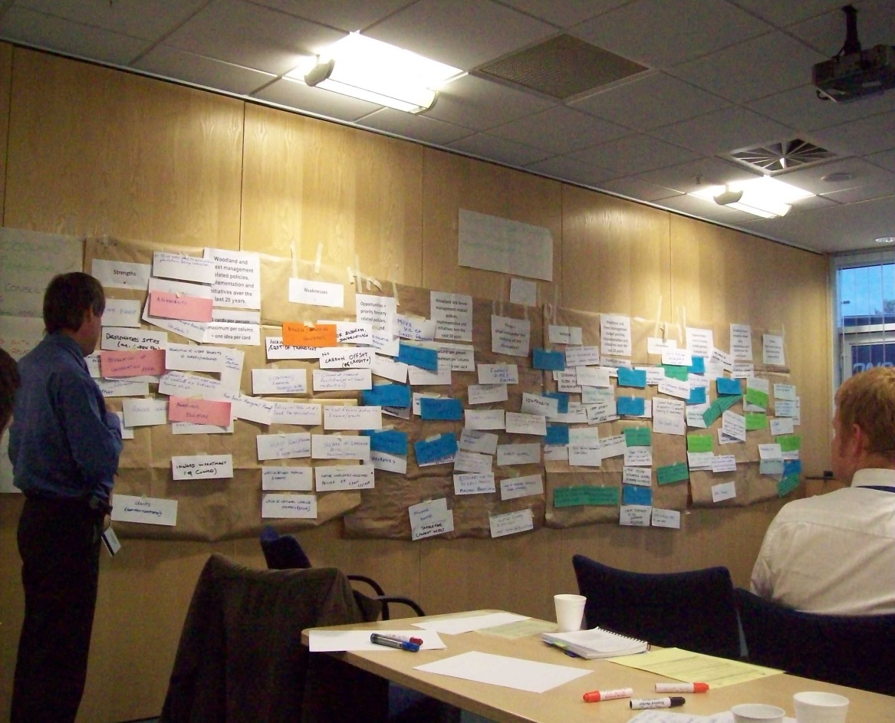
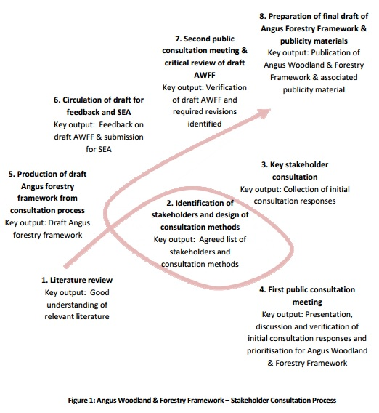
Good inclusive process led to well accepted forest strategy in Scotland that was seen as a product of society at large, not only the forest service.
Development of regional variations of the Scottish Forest policy used the process and methods that we have used in this training workshop;
Stakeholder mapping; Poster with post-its; Rights, Revenues, Responsibilities analysis, Strength Weakness; Opportunities and Threats Analysis (In photo above); Problem Analysis, Fishbowl Debate and the Solution tree/Logical Framework approach to structure the document.
Notes:
The text on the spiral to the right does not have to be seen, it is simply to show that the forest policy process spiral highlighted in this training has actually guided the development of forest policies.

Slide 13
Policy drafting and review –structuring forest policy exercise.
Purpose of exercise: To explore good practice in structuring forest policy outlines.
Logical framework guide and participatory methods can help to organise draft.
Only as far as structure/outline of policy in this short training, not on drafting details.
This exercise is more about STRUCTURE rather than CONTENT so do not spend too long on detailed content discussions.
Notes:
13

Slide 14
Policy drafting and review –structuring forest policy exercise.
Procedure:
1. You will be divided into three policy drafting teams – in line with Sustainable Forest Management and Green Economy principles.
2. Each team will go through two exercises that help develop a coherent policy outline.
3. For each exercise – each team should appoint a facilitator, who will facilitate each exercise. Facilitators should change for each exercise.
4. Please note that we will have a competition(with scoring and a prize) at the end to find which team can develop the most logical and clear policy structure.

Slide 15
Reminder of the genetic pillars of forestry in the green economy.
Vision of Green Economy: low carbon, resource efficient and socially inclusive.
Sustainable production and consumption of forest products
A low carbon
forest sector, minimizing use of non renewable resources
Decent green
Jobs/
livelihoods in the
forest sector
Long term provision of forest ecosystem services – ecological functions
Cross cutting: Policy development and monitoring of the forest sector in relation to a green economy
Note to only see this as a general generic guide to be modified depending on context.

Slide 16
Policy drafting and review – structuring forest policy exercise.
The facilitator will now demonstrate the two exercises you will be asked to use to develop the policy outline.
Guidance for the exercises are provided on handouts.
A. Solution tree
B. Logical framework - guide

Slide 17
Policy drafting and review –structuring forest policy exercise, solution tree
1. Brain storm on vision and purpose/strategy – use cards.
Vision( Expected positive change with time frame)
Step 1.
Purpose – Strategy (Priority emphasis of how and what needs to be done to reshape the forest sector to achieve the vision)
Thematic component
Objective
Thematic component objective
Thematic component
objective
Cross cutting component objective
Cross cutting component objective
2. Decide on appropriate building blocks. Often there are two types of components( theme specific – like forest types or what the forest is used for) and cross cutting components like legislation and institutional guidance.
Notes:
BIG SHEET. Prepare 3 times, each 3 flip charts wide. Print out this slide and attach as an instruction to each one.

Slide 18
Step 2: structuring the policy – using logical framework guide - see handout
Context analysis Key strengths, limitations( root causes), opportunities and threats in the forest sector( 4 sentences) Rationale for updating the policy ( 2 sentences)
B. Vision: The impact/ positive change that the policy wants to achieve in 25 years time ( 1 sentence)
C. Purpose: Summary of the key strategy or strategies that will help achieve this vision( Maximum 3 sentences)
D. Objectives/ Components of the policy. | E. Expected Results( Must be measurable) | F. Assumptions – positive conditions necessary. Rate it. Must be more than 80% chance.
Component Objective 1. | Outcome of 1( expected change) | E.g. Resources political will etc.
Component Objective 2. | Outcome of 2( expected change) | E.g. Resources political will etc.
Notes:
BIG SHEET. This should be prepared 3 times – each one about 3 flip charts size wide., there should be space to write after each of the headings – A, B and C for people to write substantive comments. Although only 2 component rows are shown on the slide, on the big sheet prepare about 7. , remember to leave space in these components, outcomes resources cells to write. You do not have to label all size components just the first one.

Slide 19
Policy drafting and review –structuring forest policy exercise, logical framework guide
Procedure:
1. Refer back to earlier outputs from the workshop to help fill contents.
2. Check vertical logic, do all the component objectives feed into purpose/strategy, does purpose deliver the vision? If not make necessary adjustments.
3. Then work horizontally, identify measurable results for each objective and state assumptions – if you do not have on average at least 80% confidence in the assumption, then you will have to revise the components or strategy until you are 80% confident.
4. If you can’t reach 80% confidence you might be able to add a new strategy that for example changes the enabling environment to raise the probability of the strategy being successful.

Slide 20
Presentation procedure – using the rotating panel method for multi-stakeholder peer review
Purpose of peer review.
Ensure policy outlines are dissected according different stakeholder perspectives and key criteria
Establish a competitive peer review dynamic to find the winning team
Notes:
No one from the presenting group should be on the panel.
Treat workshop resource persons, organizers and participants all equally when it comes to the panel.
Comments from the panelists should mix positive, negative and recommendation.
The score should reflect the comments, i.e. negative comment, low score.

Slide 21
Presentation procedure – using the rotating panel method for multi-stakeholder peer review
Procedure.
Volunteers will come forward for the panel who must assess the policy statement according to key stakeholder perspectives
Representatives of groups present according to a strict time frame
Q&A from all.
Final – strictly 1 minute comments from panellists according to their stakeholder perspective.
Finally award a score out of 10 for the performance according to your stakeholder viewpoint!
Notes:
No one from the presenting group should be on the panel.
Treat workshop resource persons, organizers and participants all equally when it comes to the panel.
Comments from the panelists should mix positive, negative and recommendation.
The score should reflect the comments, i.e. negative comment, low score.

Slide 22
Presentation procedure – using the rotating panel method for multi-stakeholder peer review
Stakeholder panellists and criteria they are interested in.
1. Government Forester. As you will be responsible for implementing the policy you are very interested in ensuring that the policy is clear, logical and coherent as well as good outcome monitoring, data collection and analysis.
2. Private forest enterprise. You are interested to see if the policy will be very positive, make forestry an attractive opportunity for investment( e.g. enterprise friendly, supporting timber and wood energy development, amenity opportunities).
3. Non Government Organisation. You are very interested in ensuring that the policy is in line with Green Economy and Green Growth – sustainable development and sustainable forest management principles.
4. Community member. You are very interested to see if the policy has a strong element of devolution – handing over secure forest tenure, user rights and forest management decision making to communities.
Notes:
HANDOUT: PRINT 5 times.
No one from the presenting group should be on the panel.
Treat workshop resource persons, organizers and participants all equally when it comes to the panel.
Comments from the panelists should mix positive, negative and recommendation.
The score should reflect the comments, i.e. negative comment, low score.

Slide 23
Presentation procedure – using the rotating panel method for multi-stakeholder peer review – score sheet
Panellists will change for every presentation – no pannellists from the presenting group!
 | Technical Forester. | Private forest enterprise. | Non Government Organisation | Community member. | Total score
Group 1.
Group 2.
Group 3.
Notes:
BIG SHEET. Prepare on 3 to 4 flip chart size side by side. With the headings technical forester, private forest enterprise, non government and community member. As well as sticking this on the big sheet, print out an extra two copies of each and keep with this big sheet, these will be needed for the exercise.

Slide 24
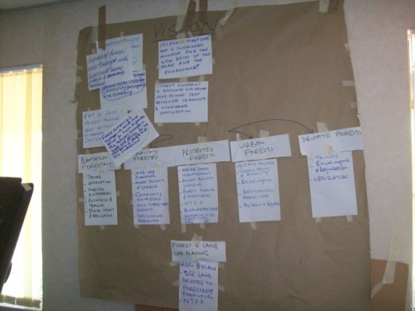
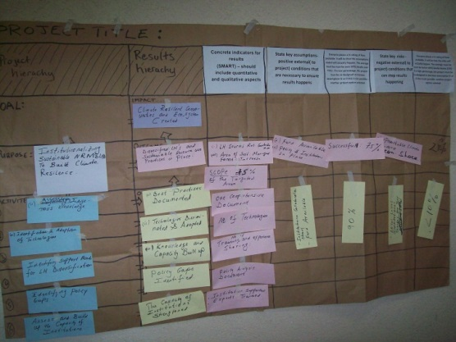
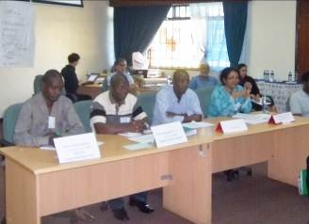
Methods reflection
Logical framework
Solution tree
Rotating panel
What did you find were the strengths?
Weaknesses/limitations?
Recommendations for applicability/adaptability?

Slide 25
Social methods tool box for engaging stakeholders and for negotiation of SFM/Green economy forest policy development – all detailed in the handout
Quick target assessment method
Poster with post-it method
Stakeholderanalysis
Problem Analysis
Strengths, Weaknesses, Opportunities and Threats Analysis
Rights, Revenues and responsibilities analysis
Fishbowl debate
Priority ranking
Rotating panel
Logical framework
Solution tree
Notes:
Tools covered so far in the training.

