Slide 1
Agenda for Day 2 - morning
Concise presentation from the training delivery reflection team on yesterday.
Rotating the responsible teams to have new responsibilities.
II. Review and Analysis continued.
Spotlight on forest data collection, analysis and management. Presentation and Questions and answers.
Exercise. Gap analysis of priority forest data according to pillars of the Green Economy.

Slide 2
Rotation of responsible teams
The responsible teams for today will now be rotated so that each team has new responsibilities.
Time keeping team | 3.
Helping and social team | 1.
Training Lessons team | 2.
Notes:
Hand over the time cards and remind new teams of their responsibilities.

Slide 3
Training flow and structure – where are we?
Components of the training | Content-topics of the training
Intro to the training SFM and green economy principles
Review and analysis skills and methods. Spotlight on data gathering and analysis
Spotlight on wood energy Policy priority negotiation Policy drafting and review
Planning the process and methods for forestry plan/strategy for the green economy development. Training evaluation
Preliminaries and principles
Review and analysis
Policy development
Outcome: Improved understanding and skills

Slide 4
II. Forestry Context analysis- Forest data gathering and management
1. The following presentation provides an overview of the principles, practice, challenges and suggestions with regards to more effective data gathering, analysis and use.
2. Following it will be an exercise on forest data gap analysis – where common forest sector related data gaps are discussed and suitable Green Economy related criteria and indicators developed which might help fill the gaps.

Slide 5
Definitions

Slide 6
FOREST SECTOR IN GREEN ECONOMY
5 pillars of Action Plan (their respective areas of activity):
Data gathering and monitoring are foundation/tool for policy
Vision for the
Forest Sector in a Green Economy
Sustainable
production
and
consumption
of forest
products
A low carbon
forest sector
Decent green
jobs in the
forest sector
Long term
provision of
forest
ecosystem
services
Policy Development and monitoring of the forest sector
in relation to a green economy
Action Plan for the Forest Sector in a Green Economy

Slide 7
Definition of SFM (defined by Forest Europe, adopted by FAO):
Sustainable forest management: It is the stewardship and use of forests and forest lands in a way, an at a rate, that maintains their biological diversity, productivity, regeneration capacity, vitality and their potential to fulfil, now and in the future, relevant ecological economic and social functions, at local, national and global levels, and that does not cause damage on other ecosystems.
Ecological
values
SFM
Economic
values
Social –
cultural
values
Notes:
Comment from Peter. This is also presented on Day 1 of the training, it can be presented quickly as a reminder if necessary but be careful not to go into too much repetition of the 1st day.

Slide 8
Criteria and Indicators (C&I) for
Sustainable Forest Management (SFM)
C&I frameworks center around seven globally agreed thematic elements (as basic criteria) of SFM:
Extent of forest resources;
Forest biological diversity;
Forest health and vitality;
Productive functions of forest resources;
Protective functions of forest resources;
Socio-economic functions of forests; and
Legal, policy and institutional framework.
Criteria define elements against which sustainability is assessed.
Each criterion relates to a key element of sustainability,
and may be described by one or more indicators.

Slide 9
NATIONAL FOREST MONITORING (NFM)
NFM is new concept elaborated by FAO in the form of
voluntary guideline to:
facilitate the understanding of importance of information management in countries,
provide ideas and guidance for further actions and
generate common basis for international cooperation.
NATIONAL FOREST INVENTORY (NFI)
NFI is multi-purpose forest monitoring and information system
which is based on statistical sampling procedures and includes:
field measurements,
spatial information,
inputs from other sources,
and modelling.

Slide 10
3 key messages

Slide 11
3 key messages THESE 3 KEY MESSAGES ARE ALSO VALID IN FOREST DATA MANAGEMENT
1. “Good decisions require good information”
Data and information are indispensable and integral part of:
planning, monitoring and reviewing
at all levels (local to national to global),
in all sectors of society (social, economic, environmental and cultural).
2. Facts and Opinions must be mutually supporting
Data and information give objective basis (common language) for discussions but:
- can be treated from different views and „dressed with different garments of interest“
or misused accidentally (poor knowledge or mishandling of data) or intentionally (manipulation or hiding).
3. Information management and policy making and
implementation are mutually dependent
Data and information management processes should be developed in line with advancement of policy ideas:
Forest policy formulation, implementation, assessment and review must:
include proper usage of information in all phases of forest policy process and
guarantee the sustainability and effectiveness of information management process;

Slide 12
3. Information management and policy making and
implementation are mutually dependent
Information management processes should be developed in line with advancement of policy ideas:
Information managers should:
“hear” the needs of stakeholders,
use flexible and cost-effective methods in data collections, and
provide well-presented, timely and relevant input to users.
Example of Armenia
The biggest issue with reliability of statistics is that unrecorded (illegal) logging, particularly woodfuel consumption by households is not reflected in official removals statistics.
The study of illegal logging carried out in 2003 assessed about 150,000 m³ of transported roundwood. The study revealed that total removals in Armenia were 847,000 m³ or about 10 times more than recorded in official statistics.
Source: Proceedings of the workshop on forest products statistics for CIS-region National Statistical Correspondents, UNECE/FAO, Moscow 2009
Possible solution:
Inclusion of woodfuel
consumption (m3)
component
into regular
household surveys

Slide 13
Why we need better information management
in
SFM for Greener Economy?

Slide 14
Rapid development of forest policies - evolving concepts:
effective and sustainable use and protection of timber resources
multi-purpose forestry and multi-stakeholder approach
increased focussing on recreation, rights of indigenous/local people, emphasis on health status of forests, cultural heritage, woodland key habitats, biodiversity protection, climate, inter-sectorial approach etc.)
sustainable forest management (SFM) formulation of criteria and indicators for SFM, and SFM for Greener Economy
Ecological
values
SFM
Economic
values
Social –
cultural
values

Slide 15
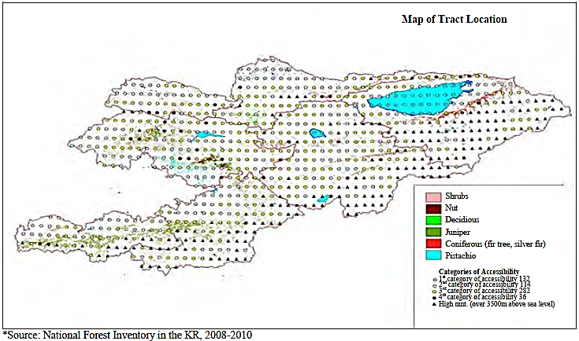
Challenges and new possibilities in data management
Raising needs of national and international reporting e.g. increased focus on forest ecosystems and services by global policy processes (UNFCCC, CBD, UNCCD etc) from 1980-s
Unequal development of National Forest Information Systems
Development of new data collection and management methods
(inclusion of new indicators , multi-source systems, use of new ICT and spatial information
possibilities, networking, high demands on specialists)
Due to inaccuracy in forest resource statistics the National Forest Inventory was carried out in 2008-2010 in Kyrgyzstan.
NFI „discovered“ 277,000 hectares of forests (1.39%) beyond State Forest Reserve and Strictly Protected Areas in Kyrgyzstan.
NFI results passed concrete issues to policy level.

Slide 16
There are typical problems in meeting data needs Not exhaustive list
Main weaknesses and constraints in the current statistical system:
In general, data from existing statistical reports are rather inaccurate, inconsistent and inadequate;
Most data on illegal logging might not be captured in official statistics;
Statistics requested by international organizations simply do not exist because they are not collected in country;
Differences in national and international definitions as well as different approaches used for data collection;
Coordination between statistical organizations and the Department of Forestry remain weak and there is no established system of exchanging statistical data in the field among organizations;
Forestry and forest-related statistics aren’t compiled and published on a yearly basis;
Cartographic material is all outdated

Slide 17
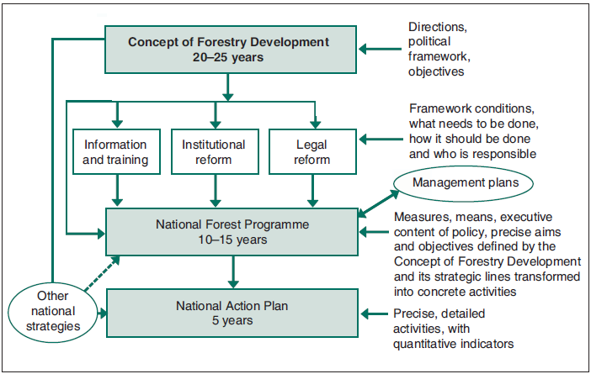
Forest information management must be continuous and full-cycle process to support forest policies
a) data collection and data compiling/processing = CREATING DATA
b) data analyses = CREATING INFORMATION = CREATING MESSAGE
c) data/information use and dissemination, including “packing”
= DELIVERING THE MESSAGE = POSSIBILITY FOR INFORMATION TO BECOME THE KNOWLEDGE
d) analysis and planning of development of information management systems which starts the new cycle …
… data collection and data compiling/processing
Example of Kyrgyzstan
Information management is
included as framework
condition.
Source: „The national forest programme
as an element of forest policy reform,
findings from Kyrgyzstan“,
I. Kouplevatskaya, Unasylva 225, 2006

Slide 18
Role of forest information systems in forest policy process
simplified approach
Dissemination and use of information
Forest policy formulation and adoption
SFM for
GREENER
ECONOMY
Analyses, planning
and development of forest information systems
Data
analyses
Analyses and review
Forest policy Implementation
Monitoring and evaluation
Data collection and processing

Slide 19
How to achieve
progress
in data management?
– helping frameworks

Slide 20
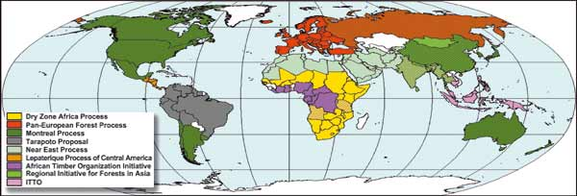
Sustainable Forest Management Criteria and Indicators (SFM C&I)
SFM C&I:
used around the globe (in ca 150 countries , 9 international C&I processes)
efficient framework to collect, store and disseminate reliable and scientifically
based information on forests and forest management
build bridges between stakeholders in forestry:
inform policy makers and public,

Slide 21
AIM of SFM C&I
Through systematic and continuous data collection, analysis and dissemination
to promote improved forest management practices, health and productivity of forests and
to take into consideration the social, economic, environmental, cultural and spiritual needs of the full range of stakeholder groups.
At national level, as tool for:
- monitoring of National Forest Programs and other related policy processes.
assisting strategic planning and monitoring SFM plans and certification schemes.
For international reporting:
national reports for international organisations, UN conventions and legally-binding agreements related to forests e.g.
FRA, CBD, CCD, CITES, CSD, OECD, UNFCCC, UNFF, WHC

Slide 22
SFM C&I
7 globally agreed thematic elements - criteria of SFM:
Extent of forest resources;
Forest biological diversity;
Forest health and vitality;
Productive functions of forest resources;
Protective functions of forest resources;
Socio-economic functions of forests; and
Legal, policy and institutional framework.
Criteria define elements against which sustainability is assessed.
Each criterion relates to a key element of sustainability, and may be described by one or more indicators.
Indicators are parameters which can be measured and correspond to a particular criterion.
They measure and help monitor the status and changes of forests and related attributes in quantitative, qualitative and descriptive terms.

Slide 23
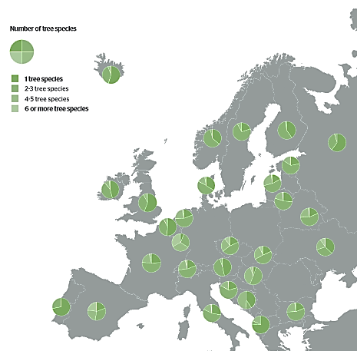
Example from Pan-European C&I for SFM
Criterion 4: Maintenance,
Conservation and
Appropriate Enhancement of
Biological Diversity in Forest Ecosystems
Indicator 4.1 Tree species composition:
Area of forest and
other wooded land,
classified by number of
tree species occurring and
by forest type
Number of tree species
1 tree species
2-3 tree species
4-5 tree species
6 or more tree species

Slide 24
SFM C&I - CONCLUSION
C&I for SFM PROCESSES CAN BE CONSIDERED AS:
link between:
technical level (data management) and
policy level (policy formulation and implementation),
forum for inclusion of stakeholders of forest and other sectors,
communication tool to inform parties at different levels and sectors
C&I for SFM IS NOT FIXED FOR COUNTRIES
It can be flexibly adjusted to national needs and emerging issues
and is practical/useful tool in progress towards SFM.
C&I PROCESSES ARE IN CONTINUOUS EVOLUTION
and need to be adapted to forest sector in green economy action plan

Slide 25
NATIONAL FOREST MONITORING
FAO has formulated key principles for information management framework at national level – NATIONAL FOREST MONITORING (NFM) which may provide helping framework for countries in coping with increasing data needs and in developing cost-effective and comprehensive forest information systems.
NFM may be considered a standard survey activity
Voluntary guidelines to:
facilitate the understanding of importance of information management in countries,
provide ideas and guidance for further actions and
generate common basis for international cooperation.
GOALS of NFM
Generate a reliable data and information base
to support formulating, monitoring and adjusting policies related to forests;
to inform interested citizens and stakeholders about the status and development of the forests and its many characteristics and services at the national level;
to facilitate discussions and the development of agreements at the international level and
to report to international conventions and processes that request the signatory nations to report on a regular basis using pre-defined questionnaires.

Slide 26
NATIONAL FOREST MONITORING
C&I of SFM should define the core attributes of national forest monitoring and assessment and should encompass broad principles that include;
Governance Principles
e.g. Country ownership and responsibility, legal basis, institutionalization of National Forest Monitoring
Scope principles (identification of information needs)
e.g. Through stakeholder engagement/participatory approaches.
Design Principles
e.g. building on what exists, flexibility, inter-sectoral and cost-efficiency.
DATA principles
e.g. good dissemination strategy, transparency

Slide 27
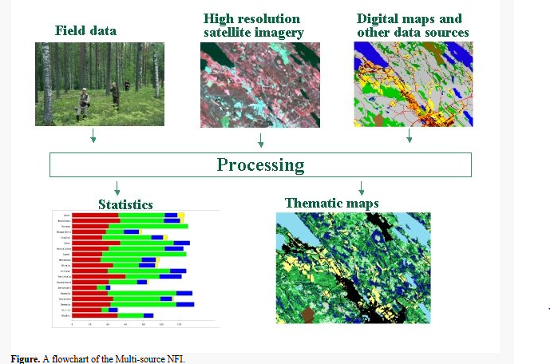
National Forest Inventory (NFI) - one of the best tools for NFM
NFI is multi-purpose forest monitoring and information system
that collect data and produces estimates about:
forest resources – area, location, growth and quality of growing stock etc,
use, management and (re)establishment of forest resources,
forest ownership,
forest health,
biodiversity of forests,
forest carbon stocks and their changes, etc
NFIs are multi-source undertakings
including:
field measurements
(on network of permanent and temporary
sample plots),
spatial information
(satellite images and digital maps),
inputs from other sources
(conservation status, ownership, soil maps etc)
modelling techniques.

Slide 28
National Forest Inventory (NFI) data/results can be used for:
reporting on forest resources (national, Global FRA, C&I for SFM, can serve as national forest statistics, etc),
evaluation of greenhouse gas emissions and changes in carbon stock of forests and forest land (Kyoto protocol reporting), including land use and relevant changes)
as input in forest and other sectors’ policy processes at national and international levels,
large-scale forest management and landscape planning,
assessing sustainability of forestry and in forest certification
planning of forest industry investments,
applied and basic research, etc
NFI is organized in cycles with periodic (after certain period) or continuous (yearly) field measurements. Value of NFI results is increasing over time – longer time-series give possibility to estimate trends (changes) and to model the future possibilities (scenarios).
NFI is one of the most cost-effective multi-purpose tool of NFM.

Slide 29
3 suggestions

Slide 30
3 SUGGESTIONS for first steps towards NFM
Carry out the inventory of existing situation:
data systems, methods, capacities,
collected data, compiled information (products), dissemination channels, involved institutions, data users etc;
assess national data needs for forest (and other) policy processes;
2. Plan carefully for both short-term and long-term developments
Elaborate (or adjust to national needs) SFM C&I set;
Identify realistic steps of development for NFM, involve partners.
Set achievable targets (e.g. publishing regular sector overviews, NFI every 5 years)
Assess costs and available resources.
3. Start implementing and develop
People (training, assignment clear tasks, provide means, involve partners), create synergies between organisations,
Tools (NFI, regular data collection routines, external data sources, consider establishment of data management/analytical unit)
Products and services (publications, reporting, public information services)

Slide 31
Thank you!
Note that details of this presentation are provided in the handout.
Any questions before we move onto the practical exercise?

Slide 32
Thank you!
Note that details of this presentation are provided in the handout.
Any questions before we move onto the practical exercise?

Slide 33
Data gathering and management – practical exercise
Useful definitions
SFM Criteria: What is important to measure? Conditions, characteristics or processes.
SFM Indicators: How to measure? Should be both quantitative and qualitative. The best indicators should be Specific, Measurable, Achievable, Realistic and Time-bound (SMART).

Slide 34
Data gathering and management – exercise
Group formation
You will be divided into 5 groups for this exercise – although contexts are difference in discussions try to find any common ground in terms of data gaps, criteria and indicators.

Slide 35
Data gathering and management - exercise
You will be divided into 5 groups to work on different topics based on pillars of the Green Economy.
1. Sustainable production and consumption of forest products( remember to think about root causes of any problems identified yesterday – e.g. governance/tenure/ownership/use rights as well as technical forest management)
Identify up to 3 key common data gaps and explain why they are important to fill. | Suitable criteria( What to measure?) | Suitable Indicators( How to measure?) | How to make the data collection feasible/cost effective?
1.
2.
3.
Notes:
BIG SHEET: About the size of 3 flip charts wide, remember to maximise the space underneath the headings beside the 1,2 and 3.

Slide 36
Data gathering and management - exercise
2. A low carbon forest sector: Promotion of forest based renewable materials and energy to replace non renewable ones.
Identify up to 3 key common data gaps and explain why they are important to fill. | Suitable criteria( what to measure?) | Suitable Indicators( How to measure?) | How to make the data collection feasible/cost effective?
1.
2.
3.
Notes:
BIG SHEET: As before

Slide 37
Data gathering and management - exercise
3. Decent green jobs and good forest based livelihoods
Identify up to 3 common data gaps and explain why they are important to fill. | Suitable criteria( what to measure?) | Suitable Indicators( How to measure?) | How to make the data collection feasible/cost effective?
1.
2.
3.
Notes:
BIG SHEET: As before

Slide 38
Data gathering and management - exercise
4. Ecological maintenance and enhancement – long term provision of Forest Ecosystem Services.
Identify up to 3 common data gaps and explain why they are important to fill? | Suitable criteria( what to measure?) | Suitable Indicators( How to measure?) | How to make the data collection feasible/cost effective?
1.
2.
3.
Notes:
BIG SHEET: As Before

Slide 39
Data gathering and management - exercise
5. Policy development and monitoring of the forest sector in relation to a green economy.
Identify up to 3 common data gaps and explain why they are important to fill. | Suitable criteria( what to measure?) | Suitable Indicators( How to measure?) | How to make the data collection feasible/cost effective?
1.
2.
3.
Notes:
BIG SHEET: As before

Slide 40
Presentation of exercise outputs
Place the presentations on the wall.
Each team must quickly present for only 5 minutes.
Quick questions will be asked all in one go, answers will then be given by the team quickly all in one go.
Ideas for questions may include the following;
1. Are the data gaps the most urgent priority to fill do you think to build towards a greener economy?
2. Are the criteria and indicators appropriate for the data identified?
3. Are the measures identified realistic – cost-effective to implement or is there a more cost effective/ appropriate way of doing it?

