Slide 1
Recreation Vehicles and GRSG
Submitted by the RV Industry Association
Informal document GRSG-117-19
117th GRSG, 8–11 October 2019
Agenda item 22
Caravans, Campers, Mobile Homes, Mobile Command Centers, and Other RV Applications under GRSG

Slide 2
R.E.3 Revision 1 (1997)
WP.29 has shown interest in recreation vehicles for decades. Twenty years ago, WP.29 envisioned establishing a separate regulation (R90) to address caravans and other recreation vehicles along the lines of UN R107 for motor coaches.

Slide 3
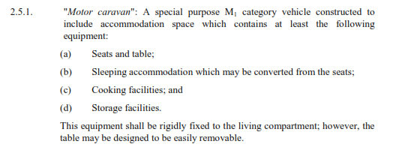
R.E.3 Revision 2 (2011)
Revision 2 in 2011 provided a definition of “motor caravan” as a Category M₁ derivative. This definition has been carried through to the current Revision 6 but does not capture the diversity of our vehicles.

Slide 4
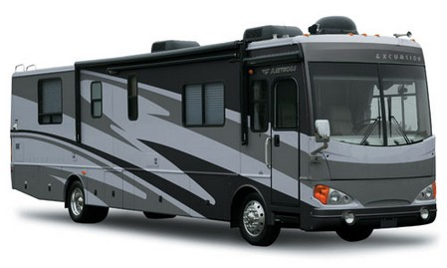
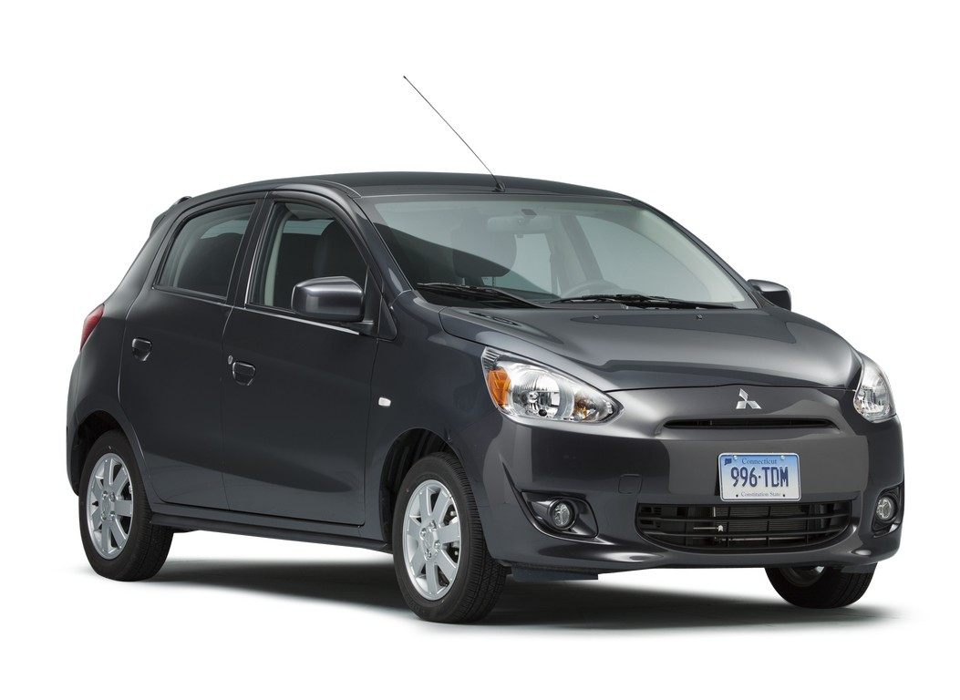
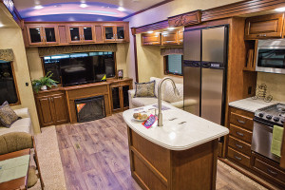
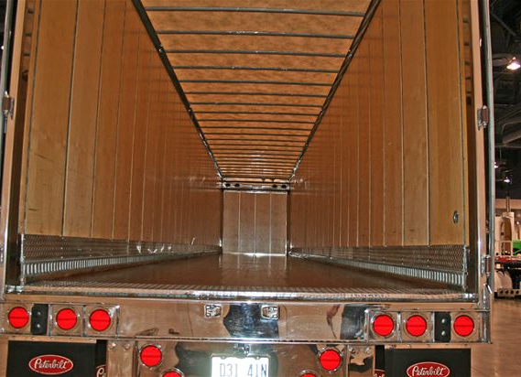
R.E.3 Categorizations
It’s clear that the technical characteristics of a bus-sized RV differ substantially from an M₁ passenger car, just as an RV trailer is quite different from a commercial trailer.

Slide 5
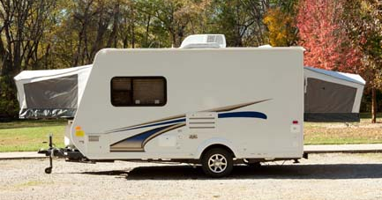
Expandable Travel Trailers
19-30 ft (5.8-9 m)
Sleeps up to eight
Smaller models can be towed by mid-size vehicles: either the family car, minivan, SUV or pickup truck
Lightweight versions have been designed for towing behind many six-cylinder family vehicles. It is important to match the loaded weight of the RV to the towing capacity of the tow vehicle.
Kitchen, dining, bathroom and sleeping areas standard, with additional amenities available depending upon size.

Slide 6
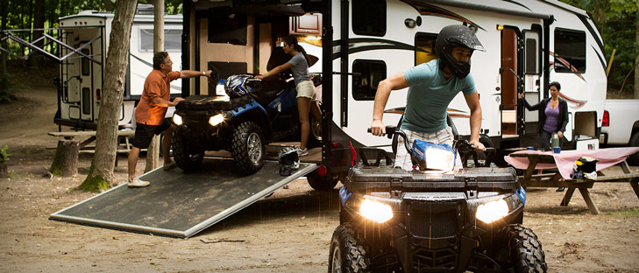
Sport Utility RV
19-39 ft (5.8-12 m)
Sleeps up to eight
Smaller models can be towed by mid-size vehicles: either the family car, minivan, SUV or pickup truck
Kitchen, dining, bathroom, entertainment and storage.
Slideouts in some models, which move the RV wall outward up to three feet
Available as a motorhome or towable unit, the rear end of the SURV drops down, forming a ramp for access into a “garage” area

Slide 7
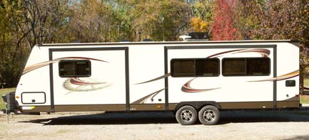
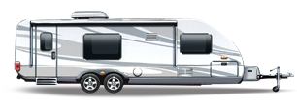
Conventional Travel Trailers
12-35 ft (3.5-10.5 m)
Smaller models can be towed by mid-size vehicles, including the family car, minivan, SUV or pickup truck equipped with a hitch.
Important to match the loaded weight of the RV to the towing capacity of the tow vehicle
Lightweight composite models are designed specifically for towing behind many six-cylinder family vehicles.
Kitchen, dining, bathroom, entertainment and storage.
Slideouts in some models move the RV wall outward up to three feet

Slide 8
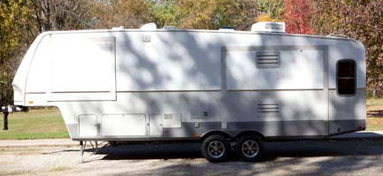
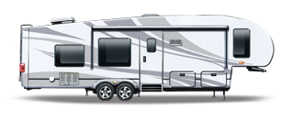
Fifth Wheel Trailers
21-40 ft (6-12 m)
Sleeps up to six
Sleeping, showering, dining, cooking, entertainment and storage
As many as four slideouts
Often have a large picture window at the rear
Lightweight models have been designed to allow the use of smaller trucks with less towing capacity
Important to match the loaded weight of the RV to the towing capacity of the tow vehicle
May require special driver’s permit

Slide 9
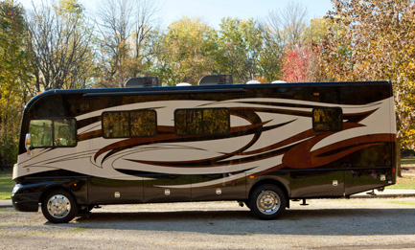
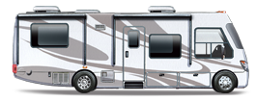
Type A Motor RV
21-45 ft (6-14 m)
Sleeps up to six
Built on specially designed motor vehicle chassis
Includes kitchens, bathrooms, living areas with entertainment centers and central heating and A/C
Designed with extensive storage capacity and often include basement storage areas.
Slideouts in some models move the RV wall outward up to three feet to create larger living areas. Many motorhome models include multiple slideouts.
Owners may tow a small vehicle
May require special driver’s license for models that utilize air brakes or exceed weight thresholds

Slide 10
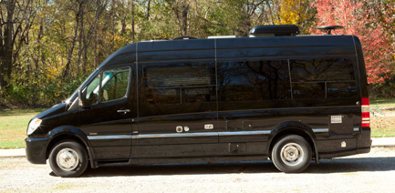
Type B Motor RV
16-22 ft (4.5-6.7 m)
Sleeps up to four
Built using van or panel-truck shells
Standard conveniences include bathroom, sleeping, dining and kitchen facilities as well as storage.
Full stand-up room is achieved by raising the roof and sometimes by the use of dropped floors, for extra interior headroom.

Slide 11
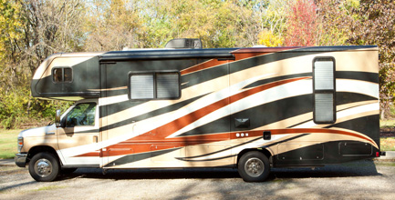
Type C Motor RV
21-35 ft (6-10 m)
Sleeps up to eight
Automotive van frame with wider body section attached to original cab section
Over-the-cab area that often with optional sleeping area. Amenities similar conventional motorhomes.
Ample living space includes sleeping, kitchen, dining and bathroom facilities, as well as entertainment systems and storage.
Slideouts in some models move the RV wall outward up to three feet at the touch of a button to create larger living areas.
Owners may tow a small vehicle
Seats can move diving/occupant space to the living space when stopped along the way

Slide 12
Vehicle Combinations
Moreover, caravans and other recreation vehicles have entirely different intended uses, including technical specifications for use in entirely different vehicle combinations than commercial trailers.

Slide 13
Vehicle Use
General license drivers
Residential accommodation
Maximum length 11.5/12.5 m
Towed by N₂
< 9000 km per year
Long idle periods
Used 4-5 times per year
Selective use in fair weather
Professional license drivers
Cargo transport
Average length 14.5 m
Towed by N₃
≈120,000 km per year
Intensive use
Economic rationale for high use
Obligatory use in all weather

Slide 14
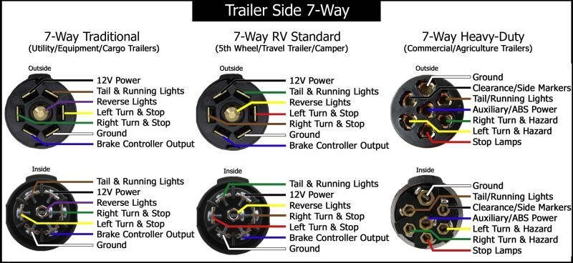
SAE J2863 and ISO 7638
These technical and use differences extend to component-level specifications intended to meet needs specific to general public use of recreation vehicles, including in combination with light and medium cars and vans.

Slide 15
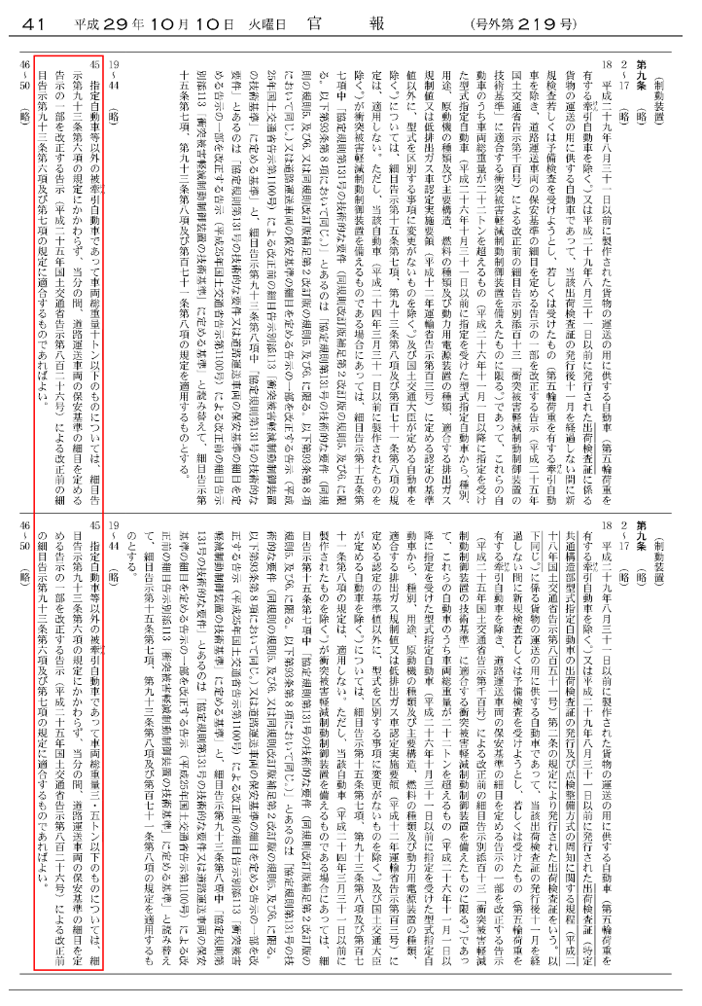
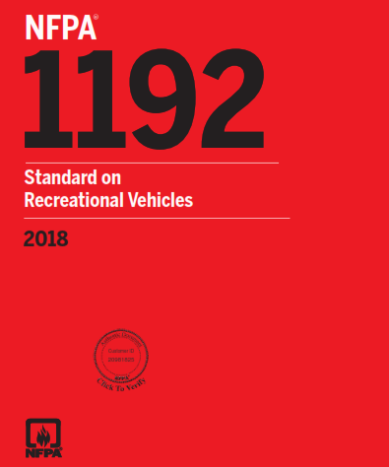
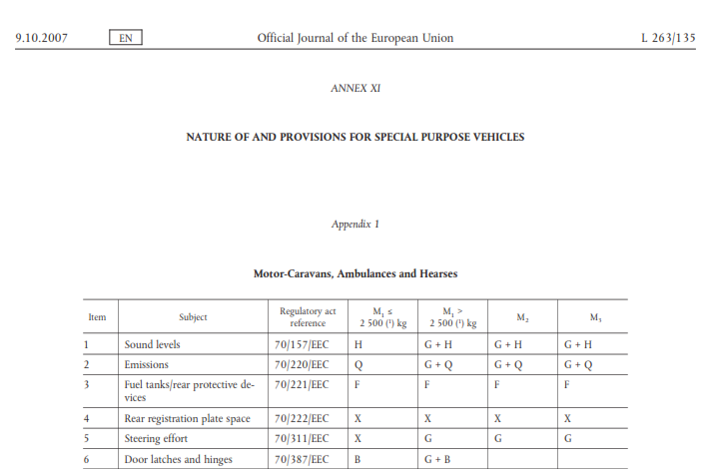
RV Technical Provisions and Exceptions
The distinct technical characteristics of caravans and other recreation vehicles have resulted in standards and legal adaptations to address their distinct needs.

Slide 16
Harmonized RV Definitions
Recreation vehicles present distinct technical characteristics.
These characteristics differ from other vehicle types.
Stakeholders worldwide have been obliged to make local provisions to address recreation vehicles.
The global RV industry believes that harmonized descriptions for recreation vehicles would benefit all stakeholders.
As the GR with deep expertise in vehicle construction, we would like to pursue this under GRSG auspices.
The global RV industry is prepared to commit resources to support such an effort.

Slide 17
Request to GRSG
Would GRSG be willing to work with the RV industry to develop a global reference guide to support the work of WP.29?
Thank you for your consideration.
For further information, please contact
Bruce A. Hopkins, Vice President, Standards
RV Industry Association
Office: +1 703 620 6003, 323
Mobile: +1 703-624-437
Email: bhopkins@rvia.org

