Slide 1
Submitted by the expert from the Republic of Korea | Informal document GRSG-116-31 (116th GRSG, 1-5 April 2019 agenda item 6(a))
Proposal for GTR No. 6 Safety glazing

Slide 2
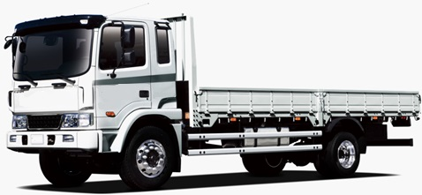
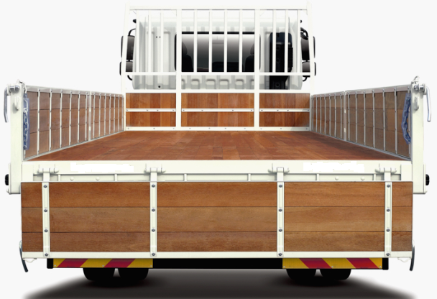
Purpose
1. In case that open type loadings tray is applied to trucks,
interior mirror application is required to secure rear view.
2. Additionally the many kinds of the truck's efficient safety/convenience
(LDWS, Autonomous sensors, etc.) options are being under development
nowsdays.

Slide 3
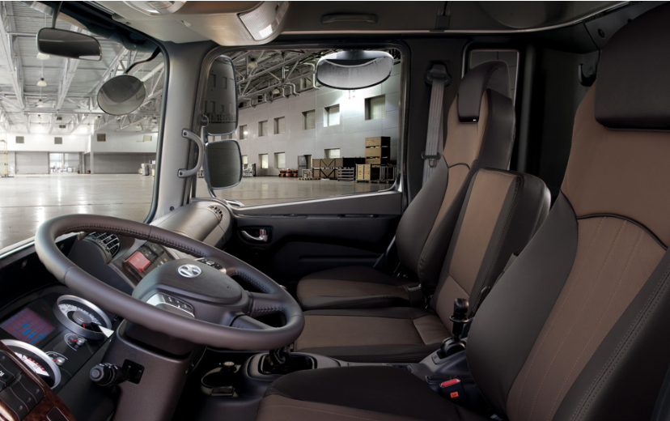
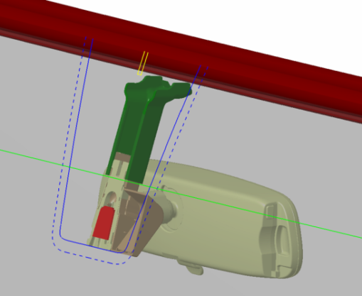
Purpose
3. If safety/convenience options are fitted to the underside of the windscreen,
it may limit the driver’s direct front of vision.
For the optimization of installation, these options may be integrated
with the interior mirror.
Integrated interior mirror

Slide 4
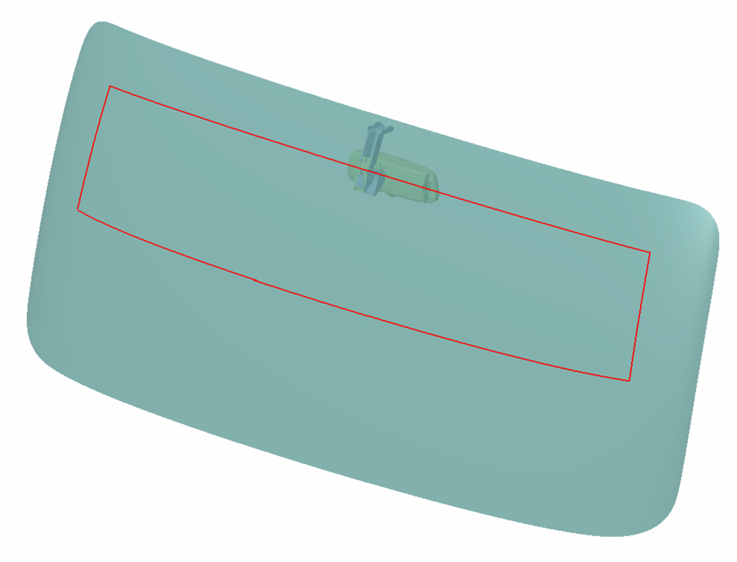
Purpose
4. However it is difficult for some models to install the interior mirror,
since Area “I” may be intruded.
Space that needs to be allowed
for opaque obscuration
Minimum space between headlining
to integrated mirror for installation
Zone ‘I’
Mounting part of integrated mirror inside windshield glass
( Intrusion part of Zone ‘I’ )
Integrated mirror assembly

Slide 5
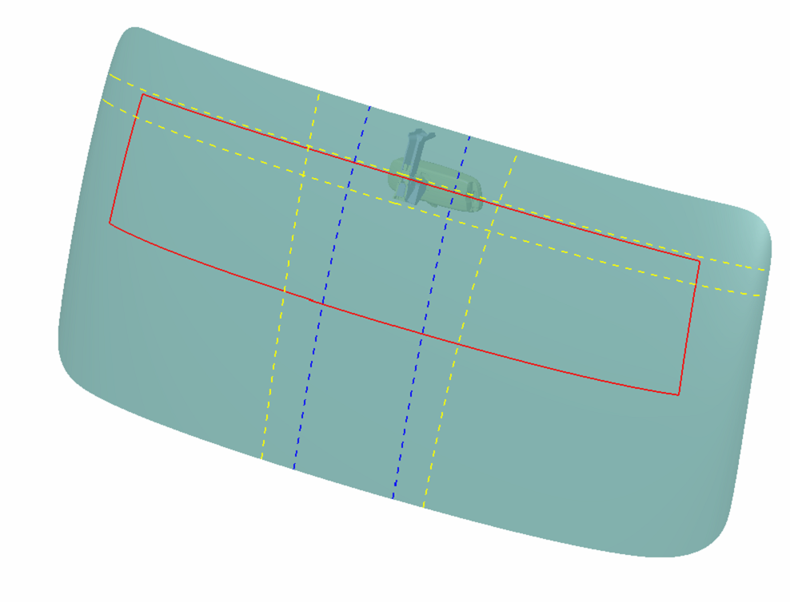
Proposal
Therefore, the opaque obscuration which is defined in paragraph 7.1.3.2.4.
of Annex is needed to be exempted in Zone I, in order to install integrated
interior mirror.
P5
P4’
300mm
P1
P4
Zone ‘I’
Opaque obscuration of
Zone‘I’ in this Proposal
(The opaque obscuration which is
defined in paragraph 7.1.3.2.4)
For reference, the same exemption has been already permitted in the requirement
of light transmittance in 7.1.3.4. of GTR 6.

Slide 6
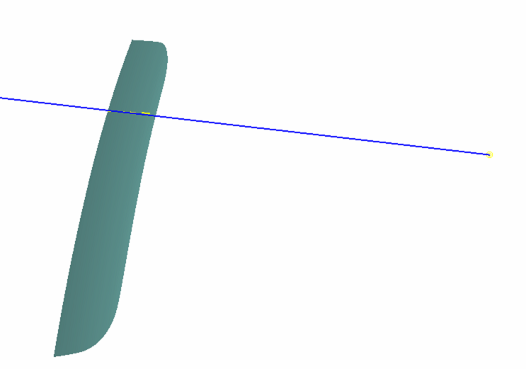
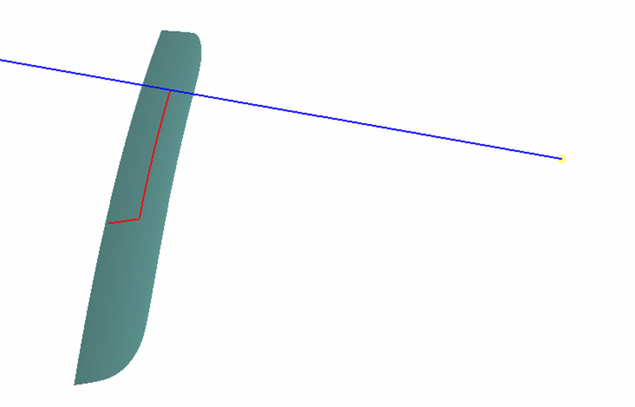
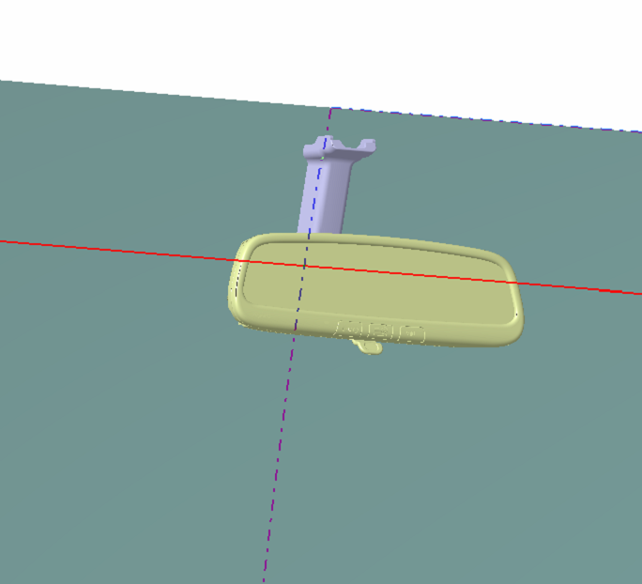
Comparison of front vision
Zone ‘I’ (before)
: Not permit opaque obscuration
Zone ‘I’ (after)
: Permit opaque obscuration
10˚
6.65˚
Point ‘O’
Point ‘O’
The driver’s front vision may be intruded by the opaque obscuration(yellow color),
but most of the opaque obscuration is already obscured by the interior mirror.
▶ Result : There is no problem with Front vision angle

