Slide 1
GRE Task Force
LED Substitutes / Retrofits (TFSR)
Status report for GRE81
Submitted by TF SR
Informal document GRE-81-14-Rev.1
(81st GRE, 15-18 April 2019, agenda item 5)
2019-04-12
K. Manz, DE (Chairman)
Ph. Bailey, UK (Vice-Chairman)
Ph. Plathner, IEC (Secretary)

Slide 2
Meetings
1st meeting: 2017-12-14, Aachen (report: TFSR-01-11)
2nd meeting: 2018-02-06, Bonn (report: TFSR-02-05)
3rd meeting: 2018-03-27, Brussels (report: TFSR-03-09)
4th meeting: 2018-06-06 Brussels (report: TFSR-04-09)
5th meeting: 2018-01-30 Aachen (report: TFSR-05-09)
6th meeting: 2019-05-15 Brussels Paris (scheduled)
Two-step approach:
Step 1: LED Substitutes
  Step 1A: light signaling applications
  Step 1B: road illumination applications
Step 2: LED Retrofits
  Technical items
  Administrative items

Slide 3
Step 1A: LED Substitutes for light signaling applications
Package of documents approved by GRE80
  R128
  RE5
  R-LSD
  R-Installation
Approved by WP29 in March 2019

Slide 4
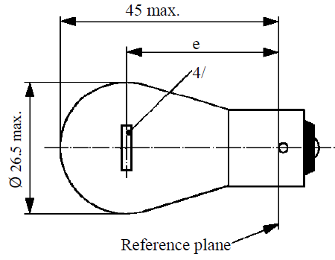
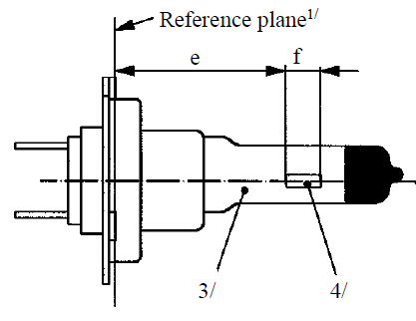
Step 1B: LED Substitutes for road illumination applications
Detailed discussion started in the 5th TFSR meeting in Aachen
on 30 January 2019
Equivalence criteria have to be extended
TFSR-05-04
Specific intensity distribution
Specific homogeneity of LEA
Contrast
…
GRE-80-02
Test voltage
Luminous flux
…
Intensity distribution
Homogeneity of LEA
…
Spectral content
Thermal behavior
…

Slide 5
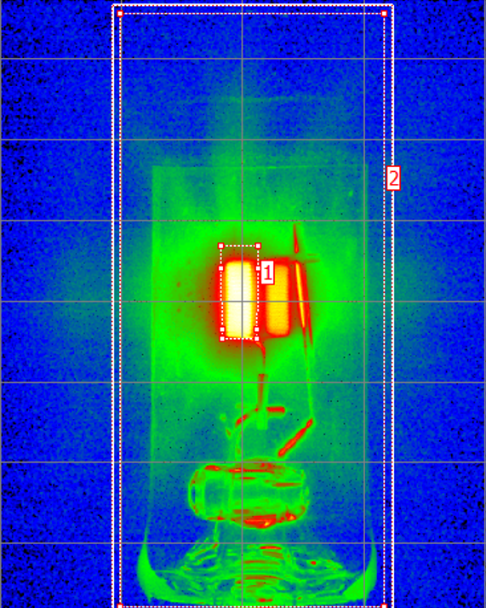
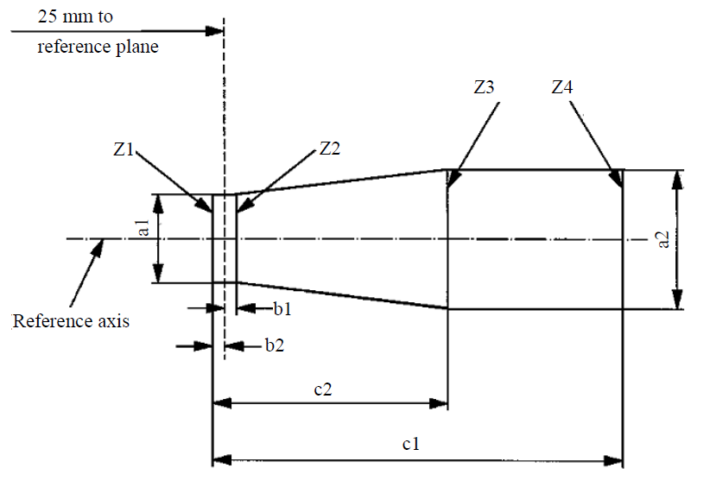
Specific aspects for road illumination
Distortion free area
Black top
Metal free zone
Controlled
ghost image
Contrast
Tighter tolerances on
filament shape, dimension, position and homogeneity

Slide 6
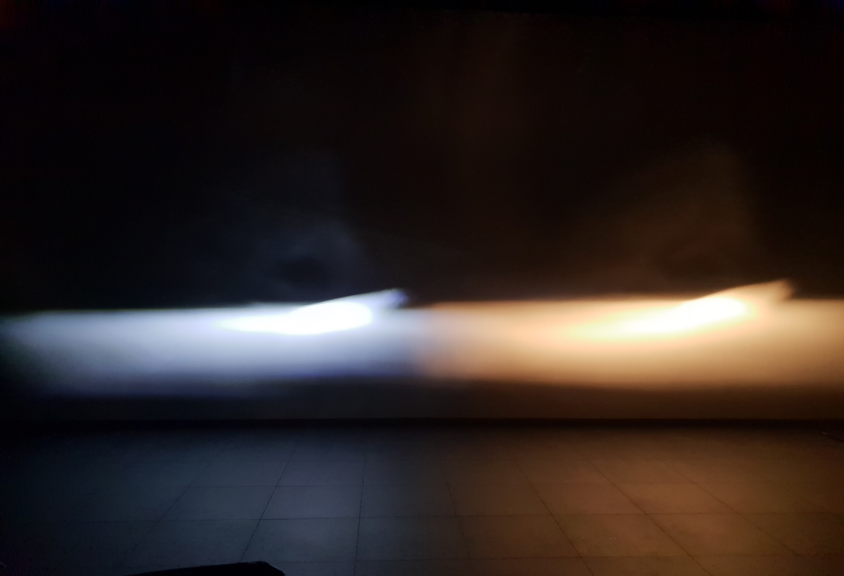
Demonstration of H7 headlamp
H7 Substitute “H7/LED”
H7 filament acc. to R37
Prototype fulfilling all proposed
equivalence criteria; TFSR-05-04
Besides the color temperature, more or less the same beam. All beam details are traceable !

Slide 7
Next Steps for GRE TF S/R
LED Substitutes for road illumination (Step 1B)
  Next meeting scheduled (Brussels Paris, 15 May 2019)
  Submit formal documents to GRE82
    Extended equivalence criteria document
    RE5 with first category sheet
    R-RID amendment
LED retrofits (Step 2)
  Technical equivalence
  Relationship between UN/ECE and national/regional laws (“legal equivalence”)
  Development of standardised failure detection

