Slide 1
Development of the Japan’s RDE
(Real Driving Emission) procedure
Informal document GRPE-76-18
76th GRPE, 9-12 January 2018
Agenda item 13
Environmental Policy Division,
Road Transport Bureau,
Ministry of Land, Infrastructure, Transport and Tourism,
Japan

Slide 2
Background

Slide 3
Background
In September 2015 in the United States, it was revealed that the manufacturer used defeat devices, which activates the emission control system during the certification test and deactivates the system during real driving.
In response to this issue, MLIT, Japan set "Working Group of Reviewing Diesel Passenger Vehicle Test Procedures for Addressing Defeat Device Issue" composed by experts of diesel emission.
The working group published a final report in April 2017 to introduce the real driving emissions(RDE) test.

Slide 4
Outline of Japan’s RDE

Slide 5
Abstract of final report and Outline of RDE in Japan
Scope
Diesel vehicles having a gross weight of 3.5t or less
Diesel powered passenger cars having a capacity of 9 or less people
Method and Requirement
[will be described later]
Schedule of Introduction for RDE in Japan
New Type Approval Vehicle : October 2022
Continuous Production Vehicle : October 2024.

Slide 6
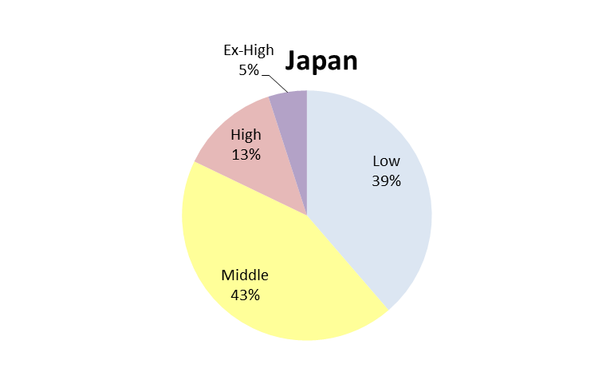
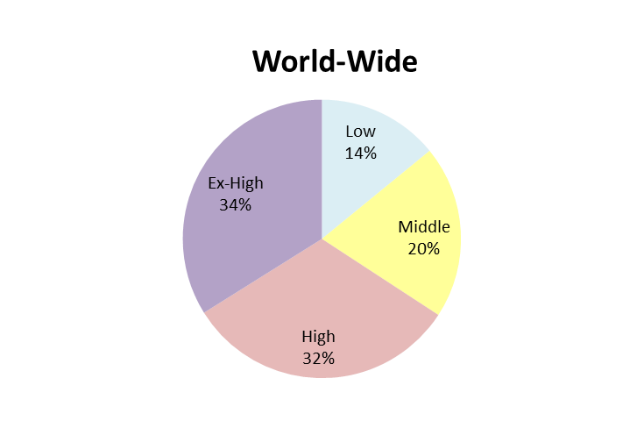
Concept of Japan’s RDE method
RDE method shall be able to check whether result of chassis-dynamometer test is effect on real driving correctly as well or not.
The Japan’s RDE method is based on EC’s RDE method, but it is slightly modified by taking into consideration difference of real world driving conditions and adopted different phase of WLTC between Japan and Europe .
Especially driving condition and speed threshold of Moving Average Window(MAW) and CF value under EC’s RDE method are developed based on chassis-dynamometer test (WLTC) and real world driving conditions.
Therefore, we modified these factors in align with driving conditions in Japan.
Traffic rate of Japan and World-Wide
EX-High
5%
Low
14%
High
13%
Low
39%
EX-High
34%
Middle
20%
Middle
43%
High
32%

Slide 7
Detail of Modifying RDE method

Slide 8
Modifying MAW method and CF value
MAW(Moving Average Window) method
We develop the MAW method in align with driving condition in Japan and 3 phases WLTC.
We modify the EC’s MAW method slightly as below.
Modifying threshold of speed from 45, 80km/h to 35, 50km/h
Modifying requirements of trip completeness to 10%
Modifying all CO2 compensation factors to 1.1
CF(Conformity Factor) value
We checked the proper CF value with the lowest emission vehicle in Japan in 2016.
In result, we got 2.0 as CF value under Japan driving condition.

Slide 9
Modifying other factors (1)
In addition to modifying MAW method and CF value, we checked other factors whether they are proper in Japan or not.
In result, we modify some of them slightly as below.
 | Japan | EC
Measurement items | NOx, CO2 Note: Japan doesn’t regulate PN under the chassis-dynamometer test and on road test. | NOx, PN, CO2
Order | 1.Urban 2.Motorway | 1.Urban 2.Rural 3.Motorway
Stop periods (<1km/h) , Low speed | No continuous 20minutes driving with less than 20km/h Test shall contain several stop periods of 10s or longer, and total stop periods is 7~36% of the time duration of urban. Every stop period doesn’t exceed 300s | Average speed of urban:15～40km/h Test shall contain several stop periods of 10s or longer, and total stop periods is 6~30% of the time duration of urban. Every stop periods doesn’t exceed 300s
Motorway | Test shall contain more than 20% of the distance of motorway with more than 80km/h. | Not exceed 145km/h above 100km/h at least 5min

Slide 10
Modifying other factors (2)
 | Japan | Europe
Time | (Same as EC) | 90-120 min
Altitude | Less than 1000m (the emissions are divided by 1.6 during higher than 700m) | Less than 1300m (the emissions are divided by 1.6 during higher than 700m)
Slope | (Same as EC) | Altitude between start and end point shall not exceed 100m Cumulative positive altitude shall not exceed 1200m/100km
Mass | (Same as EC) | Paymass90%
Temperature | -2～38℃(the emissions are divided by 1.6 during -2～0℃, 35～38℃) | -7～35℃(the emissions are divided by 1.6 during -7～0℃, 30～35℃)

Slide 11
Summary

Slide 12
Summary and Next stage of RDE method
Summary
Japan has a plan to introduce RDE regulation for some diesel vehicles from October 2022.
When developing Japan’s RDE method, we take into consideration the difference of real world driving conditions and adopted different phase of WLTC between Japan and Europe.
In result, we modify MAW method, CF value and other factors.
Next stage
Since Japan’s RDE method is based on 3 phase WLTC and can be introduced to same driving condition’s countries, we can contribute to establish UN/GTR requirement as much as possible.

Slide 13
Thank you for your attention!

Slide 14
Reference
Notes:
Next content is ‘Investigation for On-Road Test’.

Slide 15
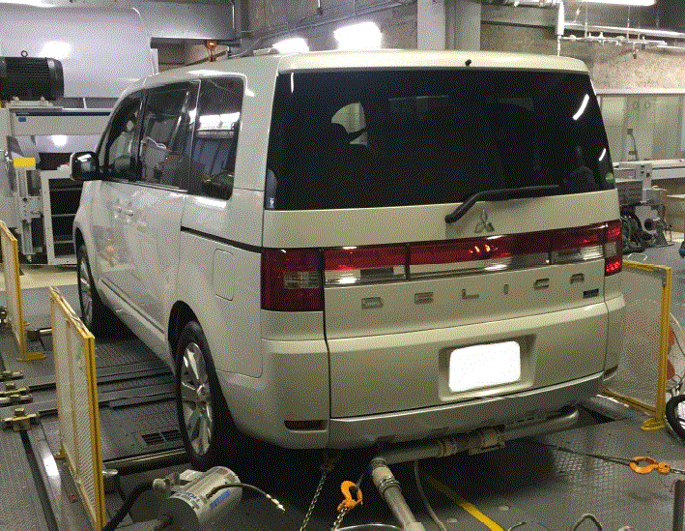
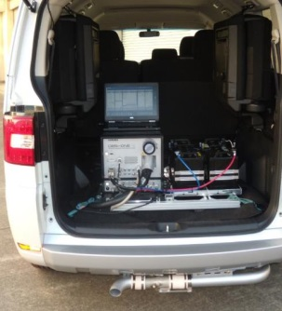
Investigation for On-Road emission in Japan
We investigated the exhaust emissions from 8 diesel-powered passenger vehicles by chassis-dynamometer testing and on-road testing
Test Procedures
1. Chassis-dynamometer testing
JC08
WLTP
60km/h constant for 30 minutes etc.
Dynamometer Testing
PEMS
2. On-road driving testing
Testing the vehicles with a PEMS in Urban, Rural and Motorway.
We analyzed the differences between the result of chassis-dynamometer testing and on-road driving testing

Slide 16
Investigation for On-Road emission in Japan
Result
The illegal software like the defeat device is not confirmed.
NOx emissions of the on-road testing are higher than those of dynamometer testing from 2 to 13 times for some models.
Difference of NOx Emissions between Chassis-dynamometer and On-road Testing
Index of NOx Emission Level
(On-Road Emission / Standard for Dynamometer)
Large Difference
Due to the protective control to stop the emission reduction system function
Small Difference
Due to the difference of test conditions and driving behavior
Urban
Rural
Motorway
Protective Control is Activated Protective Control is Not Activated

Slide 17
RDE Regulation in Europe (1)
1. History of RDE regulation
2007 Starting discussion about introduction of RDE
2011 Deciding to introduce RDE regulation
2016 Obligating to monitor on-road exhaust gas and recording it to automobile manufacturers
2017.9 Obligating to set emission standard value
2020.1 Strengthening the standard
2. Main Condition of RDE
Speed (instantaneous speed in On-Road) and Distance
Category of speed | 1. Urban （0 – 60 km/h） | 2. Rural （60 – 90 km/h） | 3. Motorway （90 km/h - ）
Percentage of distance | 29 – 44 % | 33 ± 10% | 33 ± 10%
Temperature
-7～35℃ (the emissions are divided by 1.6 during -7～0℃, 30～35℃)
CF*(Conformity Factor) value
2.1(2017-), 1.5(2020-)

Slide 18
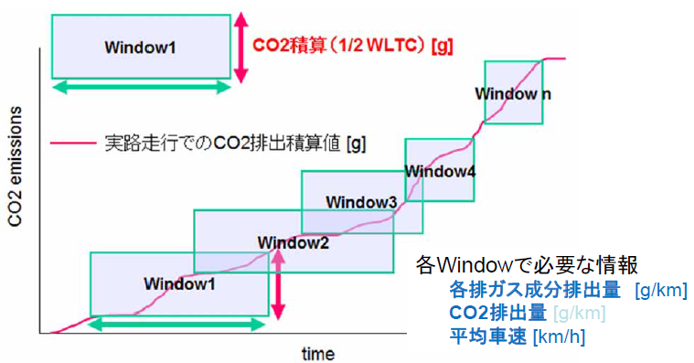
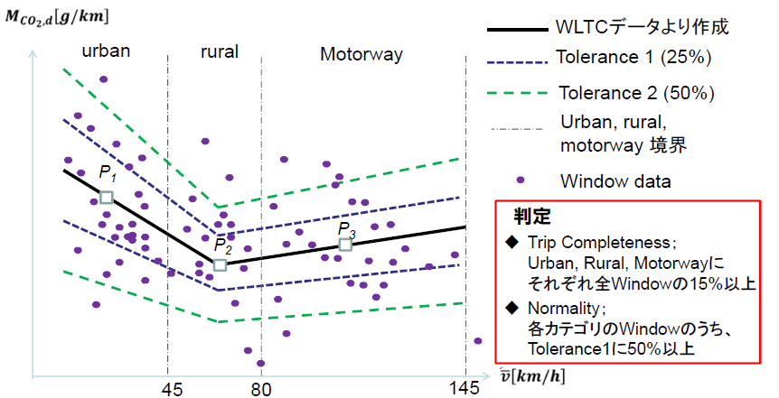
RDE Regulation in Europe (2)
3. Evaluation method of RDE（Moving Average Window method）
1. ‘Window’ is defined as a continuous period when the cumulative amount of exhaust CO2 gets the half of CO2 that is emitted by driving on WLTC mode. Windows are made at every second, and average speed and exhaust gases of each Windows are calculated.
2. CO2 Characteristic curve is made based on WLTC, and weighting factor(WF) of each Window is calculated.
3. NOx emissions as a weighted average of the windows are calculated.
CO2 emission on road
Making of CO2 Characteristic Curve
Based on CO2 emission of unit distance of WLTC mode, P1（L, M×1.2）、P2（H×1.1）、P3（Ex-H×1.05）and line P1- P2, and P2 – P3 (base line) are plotted.
Tolerance 1（WF 1）: base line ±25% Tolerance 2（WF 0-1）:base line ±50%
Threshold speed of Urban/Rural/Motorway: 45,80km/h
Requirement of MAW method of EC’s RDE
Trip Completeness：each speed category include more than 15% of all Windows
More than 50% of Window is Tolerance1 at each speed category

Slide 19
Ratio of trip distance of instantaneous speed
Condition of percentage of total trip distance of instantaneous speed in RDE
Category of speed | 1. Low speed （0 – 40 km/h） | 2. Middle speed （40 – 60 km/h） | 3. High speed （60 km/h - ）
Percentage of distance | 20 – 35 % | 30 ± 10% | 45 ± 10%
(ref) EC’s RDE
Category of speed | 1. Urban （0 – 60 km/h） | 2. Rural （60 – 90 km/h） | 3. Motorway （90 km/h - ）
Percentage of distance | 29 – 44 % | 33 ± 10% | 33 ± 10%
WLTC mode
Ratio of distance classified by instantaneous speed in WLTC mode
(Ex-High phase is not adopted in Japan)
(60 km/h – )
45%
(40 – 60 km/h )
30%
speed(km/h)
(0 – 40 km/h )
25%
time(s)

Slide 20
Checking the ratio of total trip distance (1)
Example of On-Road examination (route A)
Category of Limit speed | Low (0 - 40 km/h) | Middle (40 - 60 km/h) | High (60 km/h - )
Percentage of distance | 30.5% (16.9km） | 35.2% (19.5km) | 34.3% (19.0km)
Note: This route is set to verify method of On-Road test procedure in Europe in early stage of investigation, not to verify method in Japan.

Slide 21
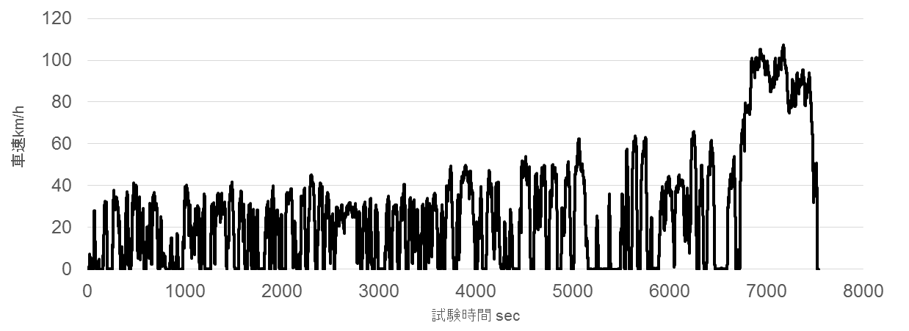
Checking ratio of total trip distance (2)
Result
It has become clear that It needs to increase the ratio of “Low speed” trip distance in Japan.
Speed chart in route A
Instantaneous speed Requirement of RDE regulation in Europe | Low (0 - 40 km/h) 20 - 35% | Middle (40 - 60 km/h) 30 ± 10% | High (60 km/h - ) 45 ± 10%
Percentage of distance | 44.5% (24.7km) | 19.8% (11.0km) | 35.7% (19.8km)

Slide 22
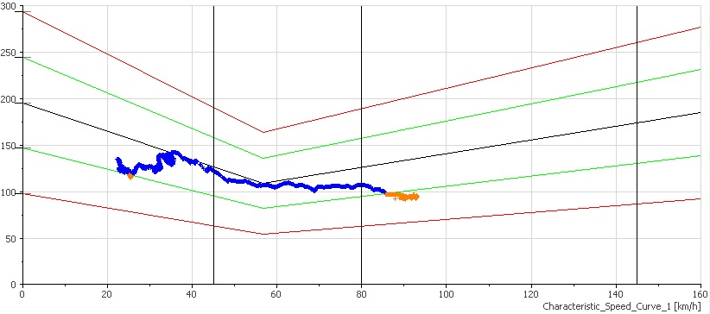
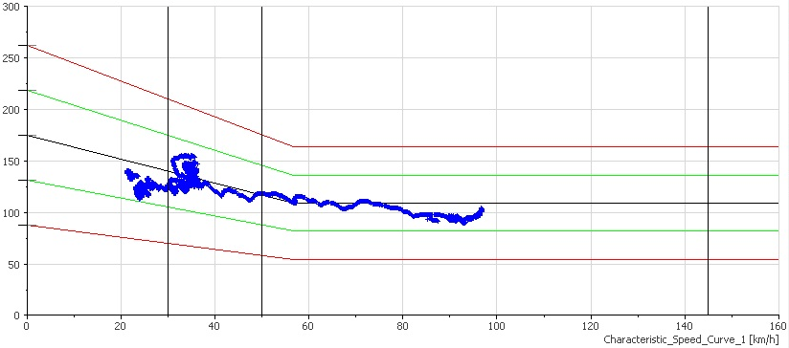
Verification of Modifying MAW method
Windows in Tolerance 1 are increased by changing Reference Point and base line.
Window bias are reduced by changing threshold speed .
Evaluation of route A
EC’s MAW method
Modifying MAW method
 | Urban | Rural | Motorway
Normality (requirement: more than 50%) | 97.5％ | 100.0％ | 44.7％
Result | PASS | PASS | FAIL
Trip Completeness (requirement: more than 15%) | 82.7％ | 11.0％ | 6.4％
Result | PASS | FAIL | FAIL
 | Low | Middle | High
Normality (requirement: more than 50%) | 100.0％ | 100.0％ | 100.0％
Result | PASS | PASS | PASS
Trip Completeness (requirement: more than 10%) | 51.1％ | 35.5％ | 13.4％
Result | PASS | PASS | PASS

Slide 23
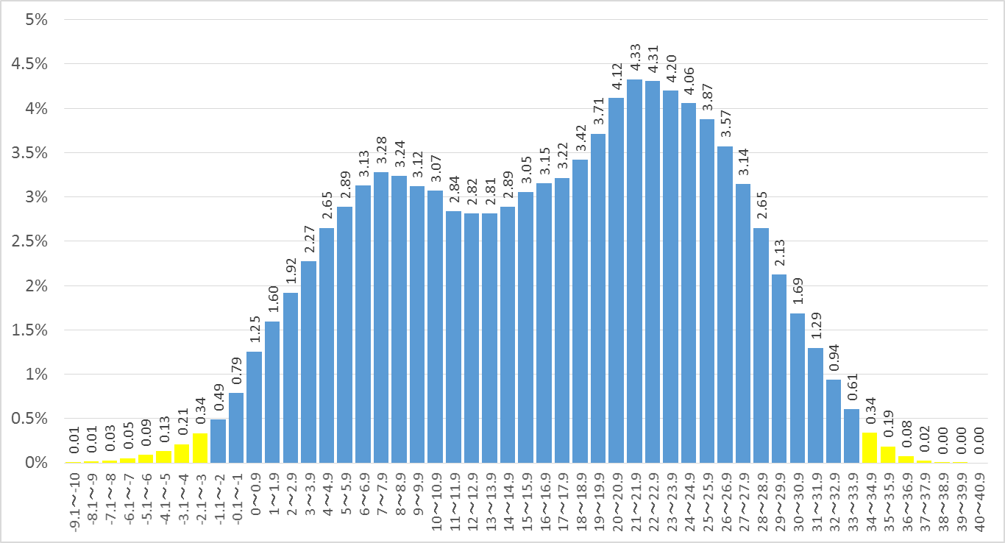
Area-mean Low Temperature in Japan
Average traffic volume for every air temperature （2012-2016）
Temp （℃） | Ratio （%） | Cumulative (%) |  | Temp （℃） | Ratio （%） |  | Temp （℃） | Ratio （%） |  | Temp （℃） | Ratio （%） | Cumulative (%)
-9.1～-10 | 0.01 | 0.01 |  | 3～3.9 | 2.27 |  | 15～15.9 | 3.05 |  | 28～28.9 | 2.65 | 9.93
-8.1～-9 | 0.01 | 0.02 |  | 4～4.9 | 2.65 |  | 16～16.9 | 3.15 |  | 29～29.9 | 2.13 | 7.27
-7.1～-8 | 0.03 | 0.05 |  | 5～5.9 | 2.89 |  | 17～17.9 | 3.22 |  | 30～30.9 | 1.69 | 5.15
-6.1～-7 | 0.05 | 0.10 |  | 6～6.9 | 3.13 |  | 18～18.9 | 3.42 |  | 31～31.9 | 1.29 | 3.46
-5.1～-6 | 0.09 | 0.19 |  | 7～7.9 | 3.28 |  | 19～19.9 | 3.71 |  | 32～32.9 | 0.94 | 2.17
-4.1～-5 | 0.13 | 0.32 |  | 8～8.9 | 3.24 |  | 20～20.9 | 4.12 |  | 33～33.9 | 0.61 | 1.23
-3.1～-4 | 0.21 | 0.53 |  | 9～9.9 | 3.12 |  | 21～21.9 | 4.33 |  | 34～34.9 | 0.34 | 0.62
-2.1～-3 | 0.34 | 0.87 |  | 10～10.9 | 3.07 |  | 22～22.9 | 4.31 |  | 35～35.9 | 0.19 | 0.29
-1.1～-2 | 0.49 | 1.36 |  | 11～11.9 | 2.84 |  | 23～23.9 | 4.20 |  | 36～36.9 | 0.08 | 0.10
-0.1～-1 | 0.79 | 2.15 |  | 12～12.9 | 2.82 |  | 24～24.9 | 4.06 |  | 37～37.9 | 0.02 | 0.03
0～0.9 | 1.25 | 3.40 |  | 13～13.9 | 2.81 |  | 25～25.9 | 3.87 |  | 38～38.9 | 0.00 | 0.00
1～1.9 | 1.60 | 5.00 |  | 14～14.9 | 2.89 |  | 26～26.9 | 3.57 |  | 39～39.9 | 0.00 | 0.00
2～2.9 | 1.92 | 6.92 |  |  |  |  | 27～27.9 | 3.14 |  | 40～40.9 | 0.00 | 0.00
Temperature data of each 47 prefectural capital (obtained by Japan Meteorological Agency) are divided into range of 1 degree, and calculated a weighing value by multiplying traffic ratio of each prefecture (obtained by road traffic census) and each time.
Yellow area is about 1% (low temperature and high temperature, respectively)

