Slide 1
Review of GRSP-2017-13e Proposal for amendments to R44 11/05/17
GRSP 61st Session May 2017
Informal Document GRSP-61 -32

Slide 2
GRSP Working Document - GRSP-2017-13e
Proposed supplement 13 to R44 (Netherlands)
This document to amend R44 to address the problems highlighted in CRS-60-05e (mifold booster cushion)
Amendments to 4 paragraphs:
Amend 6.1.8. – Main load-bearing contact point
Amend 6.2.2. – Positive guidance of loads
Amend 6.2.12. – Fitting session with generic buckle
Amend 7.2.1.1. – Contact between buckles & children

Slide 3
GRSP Working Document - GRSP-2017-13e
Amend 6.1.8.
Child restraint systems of the "universal" category, except ISOFIX universal child restraint systems, shall have a main load-bearing contact point, between the child restraint and the webbing of the adult safety-belt. This point shall not be less than 65 mm vertically above the test bench cushion and not be less than 150mm from the Cr axis when measured with the child restraint on the dynamic test bench installed in accordance with Annex 21 to this Regulation without a dummy. This shall be measured in a longitudinal plane making use of the Standard seat belt configuration for the fitting session described in figure 1C of Annex 13. This shall apply to all adjustment configurations.
Additional alternative belt routes are allowed. Where an alternative belt route exists, the manufacturer shall make specific reference to the alternative route in the user instructions, as required in paragraph 15. When tested, using such alternative belt route(s), the restraint shall comply with all the requirements of the Regulation. with the exception of this paragraph.
Clepa proposal:
Limitation to 65mm vertically above the cushion for all “universal” CRS is going to far and will exclude existing products.
Clepa proposing to split the 6 1 8 into 2 parts
Integral child restraint systems of the "universal" category, except ISOFIX universal child restraint systems, shall have a main load-bearing contact point, between the child restraint and the webbing of the adult safety-belt. This point shall not be less than 150mm from the Cr axis when measured with the child restraint on the dynamic test bench installed in accordance with Annex 21 to this Regulation without a dummy.
Non-integral child restraint systems of the “universal” category, shall have a main load-bearing contact point, between the child restraint and the webbing of the adult safety-belt. This point shall not be less than 65 mm vertically above the test bench cushion and not be less than 150mm from the Cr axis when measured with the child restraint on the dynamic test bench installed in accordance with Annex 21 to this Regulation without a dummy.
In each case, this shall be measured in a longitudinal plane making use of the Standard seat belt configuration for the fitting session described in figure 1C of Annex 13. This shall apply to all adjustment configurations. Additional alternative belt routes are allowed. Where an alternative belt route exists, the manufacturer shall make specific reference to the alternative route in the user instructions, as required in paragraph 15. When tested, using such alternative belt route(s), the restraint shall comply with all the requirements of the Regulation.
Reason: “Universal” category includes integral and non-integral CRS

Slide 4
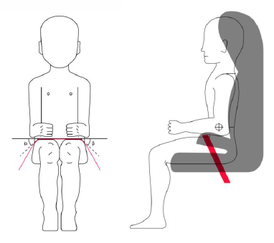
GRSP Working Document - GRSP-2017-13e
Amend 6.2.2.
For groups I, II and III, all restraint devices utilizing a "lap strap" shall positively guide the "lap strap" on both sides to ensure that the loads transmitted by the "lap strap" are transmitted through the pelvis. The assembly shall not subject weak parts of the child's body (abdomen, crotch, etc.) to excessive stresses. The positive guidance of loads over the pelvis shall be realized from the moment that the child is installed; the lap belt shall pass rearward on the thighs, just touching the fold with the pelvis. The angles α and β between the tangent line in which the belt touches the thighs and the horizontal shall be greater than 10°.
The assembly shall not subject weak parts of the child's body (abdomen, crotch, etc.) to excessive stresses.
Clepa Proposal :
6.2.2. All restraint devices utilizing a "lap strap" shall positively guide the "lap strap" on both sides to ensure that the loads transmitted by the "lap strap" are transmitted through the pelvis. The assembly shall not subject weak parts of the child's body (abdomen, crotch, etc.) to excessive stresses.
Insert a new section : 6.2.3. 6.2.3. In the case of booster seats, the lap portion of the adult seat belt shall be positively guided on both sides to ensure that the loads are transmitted by the adult lap belt are transmitted through the pelvis. The positive guidance of loads over the pelvis shall be realised from the moment that the child is installed; the lap belt shall pass over the proximal thigh, just touching the fold with the pelvis. The angles α and β between the tangent line in which the belt touches the thighs and the horizontal shall be greater than 10°.
the thighs and the horizontal shall be greater than 10°.
Reason: “Lap strap” applies to any belt, including harness belts

Slide 5
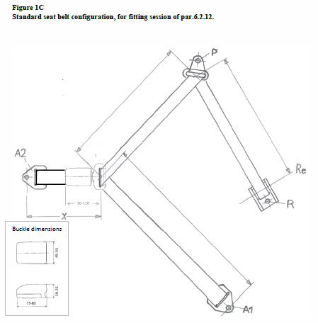
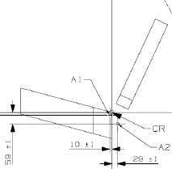
GRSP Working Document - GRSP-2017-13e
Amend 6.2.12.
In case of booster cushions non-integral child restraint systems, the ease with which the straps and tongue of an adult belt pass through the fixture points shall be examined. This goes particularly for booster cushions which are designed for the front seats of cars, which may have long semi-rigid stalks. The fixed buckle should not be allowed to pass through the fixture points of booster seats, or to permit a lie of belt completely different from that of the test-trolley. This shall be tested during a separate fitting session on the test bench by replacing the central part of the standard safety belt (figure 3 of Annex 13) and the flexible strap to part A2, with respectively, a tongue and a generic buckle attached to a flexible strap with an adapted length such that, the combination of A2, adapted flexible strap buckle and tongue are projecting 150 mm outside the Cr point.
Clepa position:
The benefit of this additional test is unclear
Aside from one of 2 specific products we are not aware of issues in real world for the majority of CRSs .
Technical Service Group has discussed this procedure and has reservations about its application in approval process
The term “fixture points” needs to be defined / clarified .
Need to test the procedure before it is adopted

Slide 6
GRSP Working Document - GRSP-2017-13e
Amend 7.2.1.1.
The buckle shall be so designed as to preclude any possibility of incorrect manipulation. This means, inter/alia, that it shall not be possible for the buckle to be left in a partially closed position; it shall not be possible to exchange the buckle parts inadvertently when the buckle is being locked; the buckle shall only lock when all parts are engaged. Wherever the buckle and /or the tongue are is in contact with the child, it shall not be narrower than the minimum width of strap as specified in paragraph 7.2.4.1.1 below. This paragraph is not applicable to belt assemblies already approved according to ECE Regulation No. 16 or any equivalent standard in force. In the case of a "Special Needs Restraint" only the buckle on the primary means of restraint need comply with the requirements of this paragraph 7.2.1.1. to paragraph 7.2.1.9. inclusive."
Clepa Position
CLEPA assumes that this proposal aims to prevent concentrated loading from the entire buckle assembly of integral child restraint systems.
We therefore support the proposal.

