Slide 1
OICA comments to GRRF-83-13 / TPMS Field Study
Informal document GRRF-83-16
83rd GRRF, 23-27 January 2017
Agenda item 7(j)
UNECE GRRF-83, 23-27 January 2017

Slide 2
Reflections on T&E report

Slide 3
Overview on tests used for the T&E report
Analysis of tests conducted, based on information available :
20 tests per vehicle
4 tests claimed to be according to the UN R64/R 141 => all tests passed
8 tests performed with 1.4 bar followed by a reset: - calibration at 1.4bar is an intended misuse case => intended misuse cannot be prevented
8 tests were conducted in a way, neither relevant for the customers nor real world driving.

Slide 4
Background to regulation
Puncture
Focus on normal punctures, not blowouts.
Process that takes in the order of 10 – 30 minutes up to some days.
Diffusion
Slow process that takes months
Regulation test procedures were designed to address real world pressure loss scenarios with testability in mind
For an iTPMS it is easier to handle daily customer usage than the test procedures.

Slide 5
Artificial diffusion test
Diffusion is a slow pressure loss that takes months:
Considered in the design of indirect TPMS and in the regulatory test procedure.
T&E Tests performed:
20 minutes of driving at constant speed
Then reduce pressure with a 20% step (all 4 tyres)
Afterwards drive at another constant speed Artificial scenario likely not happen in real life:
Diffusion is slow process, not a step.
It is impossible to drive constantly at one speed (e.g. 140 – 150 km/h as in one of the test cases) for several months.

Slide 6
Conclusion
The T&E publication includes statements that are not correct and misleading
OICA welcomes any fact based discussion on how to improve road safety.
For this purpose OICA is conducting a TPMS field study.

Slide 7
Status of TPMS technology
TPMS Field Study 2016/17

Slide 8
Reasons for TPMS Field Study
No scientific based study available covering TPMS assessment and its effectiveness in Europe
Concerns circulating about TPMS effectiveness
Receive certainty on field status

Slide 9
Scope of the Investigation
Collect data which enables an analysis of the effectiveness of TPMS in general and iTPMS and dTPMS in comparison including
Current tyre inflation pressure
Tyre sidewall and ambient temperature
Tyre dimension
Vehicle load state
Applicable tire pressure recommendation according to manufacturer
TPMS fitment & technology

Slide 10
Methodology
Approach passenger car drivers randomly at filling stations or shopping centers and ask for permission to participate in the study.
Check load state and tyre dimension(s) and determine the recommended tyre pressure(s).
Check TPMS fitment (lamp check, visual inspection, users manual, ...).
Measure tyre pressures.
Measure tyre sidewall temperatures with IR thermometers and the ambient temperature.
Compensate the measured pressures with the difference between ambient and sidewall temperature.

Slide 11
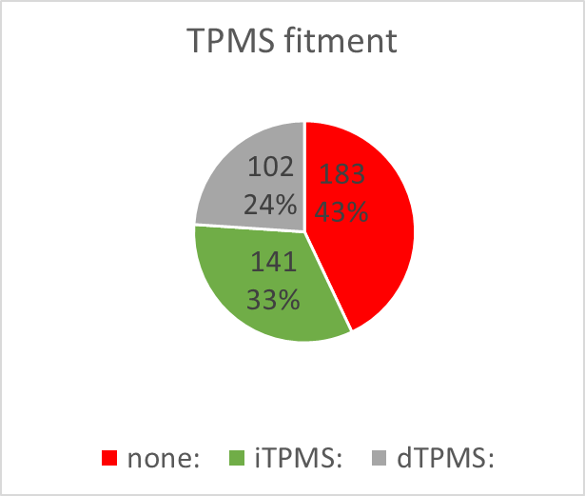
Study Size and Certification
n=426 (as of Jan 18, 2017)
Locations: Linköping (S) and Hanau (D)
TÜV Nord involved since Jan 2017 in process certification and data collection
Raw data is available

Slide 12
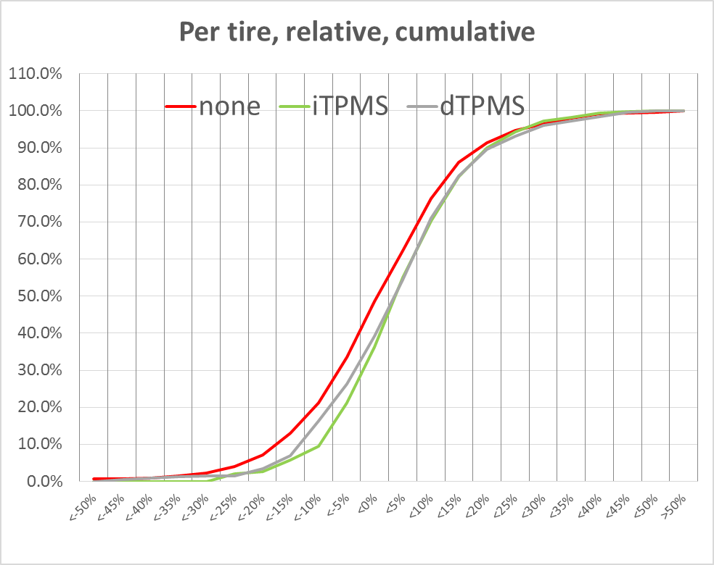
Preliminary Results
The mandatory fitment of TPMS is effective
Both dTPMS and iTPMS increase the average inflation pressure by ~3,5%-points compared to vehicles w/o TPMS.
TPMS fitment (independent of technology) reduces the number of severely underinflated tires by ~50% this is perfectly in line with the 2012 NHTSA study.
No cases found for TPMS equipped vehicles with severe underinflation but no warning
Some cases found with drivers ignoring TPMS warning
Fraction of population
Tire deflation

Slide 13
TPMS reset misuse prevention

Slide 14
TPMS Reset Misuse Scenarios
TPMS Reset
Important function for both, direct & indirect TPMS in oder to reflect different load cases, tyres, etc.
TPMS Reset Cases
Unintended misuse:
Blocked swich / button due to load, etc.
Reset at undiscovered puncture
Wrong pressure value adjustment
Intended misuse:
- Driver wants to get rid of warning

Slide 15
TPMS Reset Misuse Scenarios
All reset misuse scenarios are already addressed by implemented reset logic/functions and relevant information
OICA is willing to elaborate on draft amendments regarding more detailed reset function requirements

