Slide 1
Alignment of Regulation 96 to Regulation (EU) 2016/1628
Informal document GRPE-74-13
74th GRPE, 9-13 January 2017,
Agenda item 6(a)

Slide 2

UNECE Regulation 96
on
Uniform provisions concerning the approval of compression ignition (C.I.) engines to be installed in agricultural and forestry tractors and in non-road mobile machinery with regard to the emissions of pollutants by the engine
R96 covers only part of the scope of EU Stage V* Regulation.
R96 includes in its scope T vehicles which will be subject to equivalent Stage V legislation, under development.
Need to align R96 limits to EU Stage V Regulation.
*Stage V = REGULATION (EU) 2016/1628

Slide 3
Work Progress
Guiding principles of the 05 series of amendment
  Follow R96-04 structure
  Mirroring the scope of EU Stage V
    IWV & Rail out of scope for WP29
  Keep R96 as a core Type Approval legislation
    Exemptions and particular provisions to remain only in national/regional legislation
  Alignment of the R96 technical annexes to the EU Stage V Delegated and Implementing Acts.
    Examples:
      deletion of annex 4A in R 96
      Addition of PN measurements
The previous series of amendments remain in force for contracting parties wishing to apply them.

Slide 4

Scope Evolution
R 96-05
NRMM + T
CI and SI engines
Liquid and gaseous fuelled
0 to ∞ kW
R 96-04
NRMM + T
CI engines
19 to 560 kW
SI < 19 kW
IWV & RAIL
IWV & RAIL

Slide 5
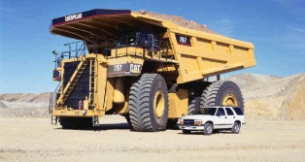
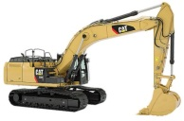
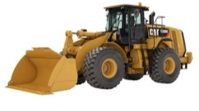


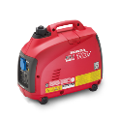

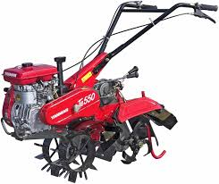

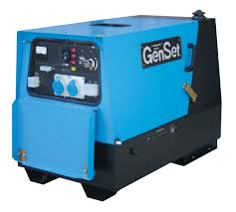
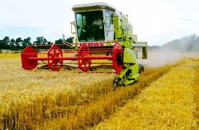

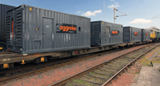
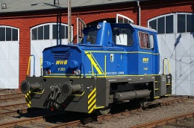
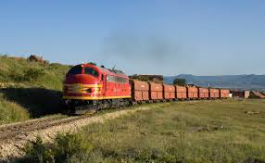

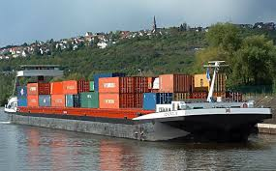

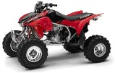
New NRMM Regulation
Regulation (EU) 2016/1628
Land-based NRMM
SI – Spark-ignited (gasoline)
SI 0-19kW
SI 19-56kW
>560kW
56-130kW
130-560kW
Gen-Sets >560kW
CI 0-8kW
CI 8-19kW
CI 19-37kW
CI 37-56kW
CI – Compression-ignited (diesel)
Rail - Locomotives
>0kW
Rail - Railcars
>0kW
Inland Waterway Vessels (IWV)
37-75kW
75-130kW
130-300kW
300-1000kW
≥1000kW
Auxiliaries 560-1000kW
Auxiliaries ≥1000kW
Snowmobiles
Scope of Directive 97/68/EC
>0kW
Scope extensions new NRMM Regulation
All Terrain & Side-by-Side Vehicles
>0kW

Slide 6
Contents

Slide 7
Contents (cont.)

Slide 8
Contents (cont.)

Slide 9
Contents (cont.)

Slide 10


Timing
Planned to submit a first draft as informal document to next GRPE session (June 2017)
Publication goal
In order to ensure adequate EU market alignment and contemporary EU and UN ECE approvals in view of Stage V, the new amendment should ideally be published in 2018.
Regulation 120
Also Regulation 120 will need update to maintain alignment on some specific provisions like:
Accessories installed for engine power determination
Reference fuels
Information document
This can be done as a sister activity of the main one.

Slide 11

Acknowledgements to contributors such as Italy and EUROMOT

