Slide 1
Additional Explanations to ECE/TRANS/WP.29/GRE/2016/35
Transmitted by the expert from Japan
Informal document GRE-77-19
(77th GRE, 4-7 April 2017
agenda item 7 (c))
MLIT, Japan
(Ministry of Land, Infrastructure, Transport and Tourism)

Slide 2
This document provides Japan’s view to the above comments.
Background
At the 76th session of GRE, Japan submitted Formal Document ECE/TRANS/WP.29/ GRE/2016/35 to propose that headlamps of motorcycles equipped with optional daytime running lamps (DRLs) shall automatically be switched ON at night.
On the other hand, the following comments were provided for this proposal by some experts in the last session.
There is a possibility that Motorcycles have technical problem to be installed with illuminance sensors which enables automatic switching from DRLs to headlamps.
Automatic switching may be an excessive burden on motorcycles from the viewpoint of cost.

Slide 3
Justification of the proposal
1. The necessity of automatic switching from DRLs to headlamps
Several researches* conducted by Japan showed that using DRLs on motorcycles at night causes glare to drivers of oncoming vehicles.
(* Informal document No. GRE-75-09 and GRE-76-03)
As specified in Regulation No.87, technical requirement for DRLs of motorcycles is exactly the same as those of four-wheeled vehicles whose “automatic switching” function are mandatory.
Based on the above, motorcycles equipped with DRLs also need to have “automatic switching” function.

Slide 4
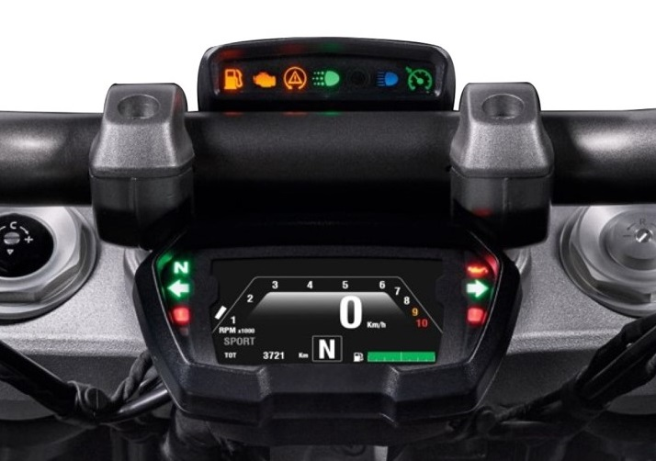
Justification of the proposal
2. “Automatic switching” of motorcycles has already put to practical use widely.
According to results of investigation by Japan.
- 17 models out of 20 sold in Europe are equipped with “automatic switching” function including illuminance sensors.
- All 10 models imported to Japan with “automatic switching” function are equipped with illuminance sensors in instrument panels covered with panel cases.
- Manufacturers decides each criteria of sky illuminance for “automatic switching”.
As mentioned above, since “automatic switching” of motorcycles has already put to practical use widely, technical problem for motorcycles to be installed with “automatic switching” cannot be found.
Example of motorcycles instrument panel

Slide 5
Justification of the proposal
3. “Automatic switching” is not mandatory for motorcycles without DRLs.
DRLs installed on motorcycles are not mandatory but optional lighting devices. That is , manufacturers can freely decide whether they install or does not install DRLs on motorcycles.
On the other hands, “automatic switching” in Japanese proposal are mandatory only on motorcycles equipped with DRLs optionally.
Furthermore, cost of installing illuminance sensors are sufficiently lower than that of installing DRLs.
Based on the above, it is not considered that Japanese proposal can be an excessive burden on motorcycles from the viewpoint of cost.

