Slide 2
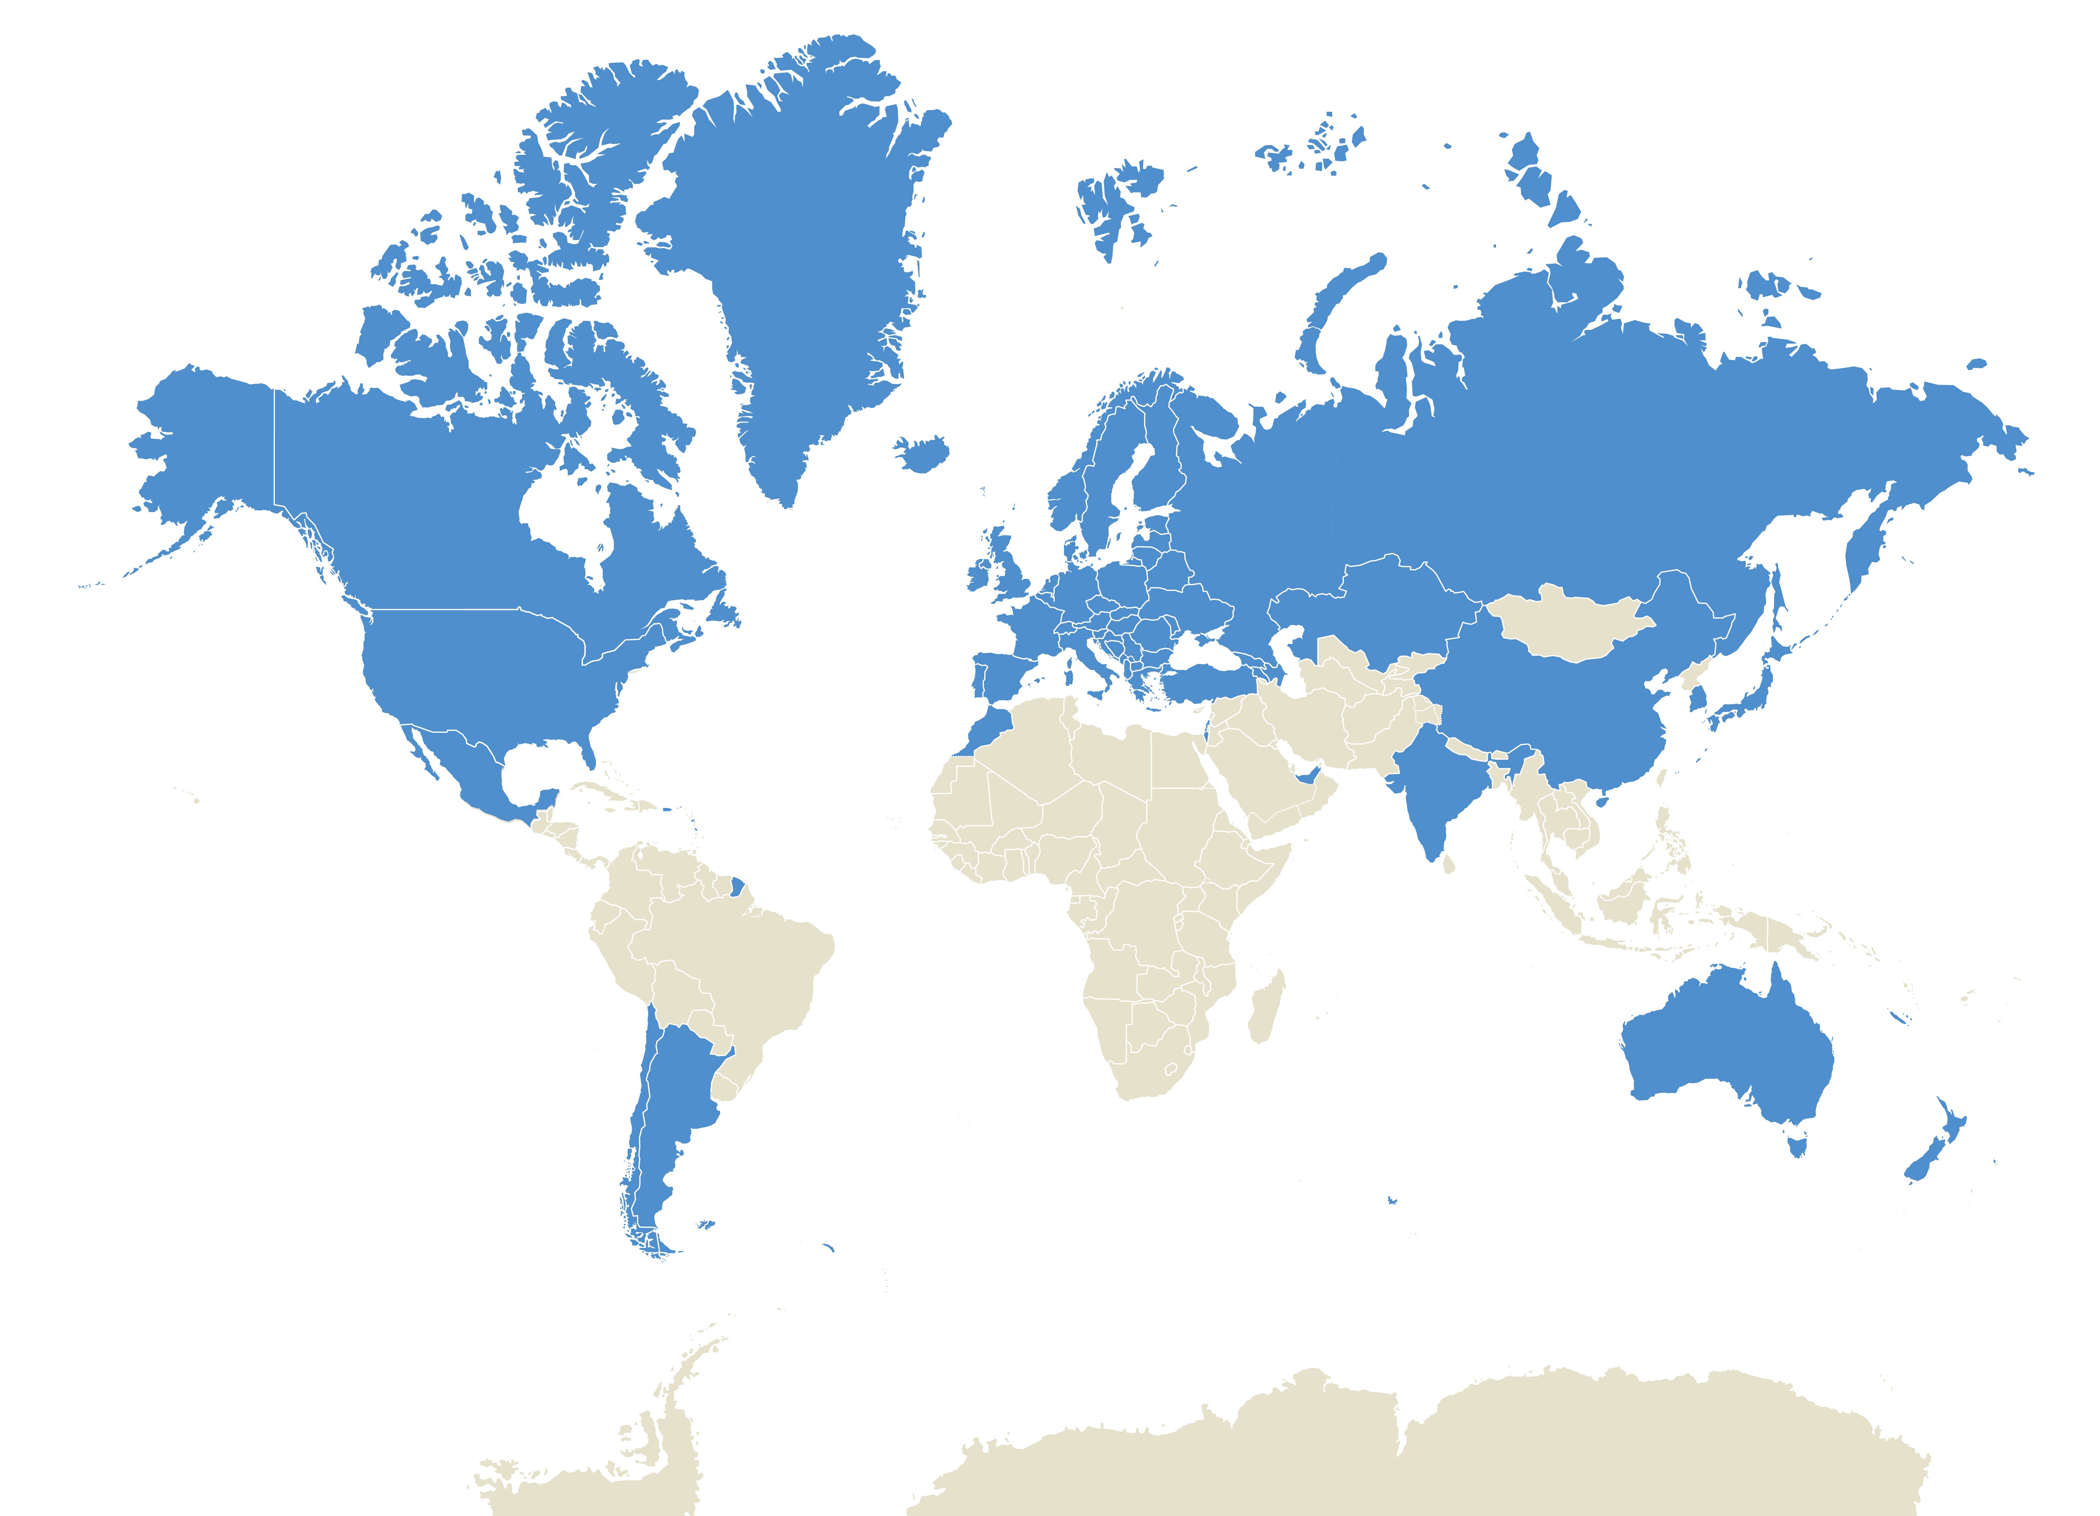
ITF Global Outreach
Intergovernmental organisation
59 member countries (25 non-OECD)
Annual Summit
Transport policy issues across all modes and topics

Slide 3
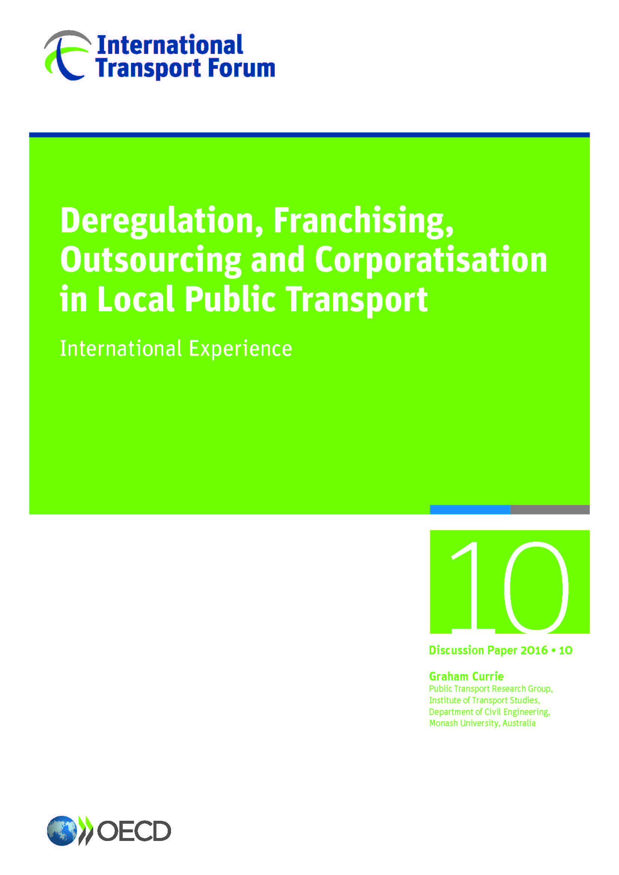
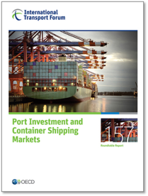
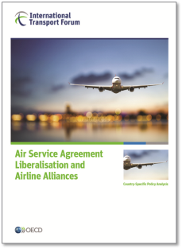
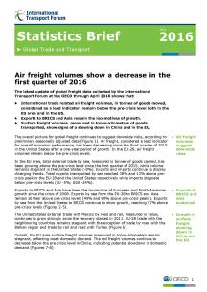
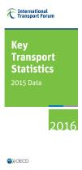
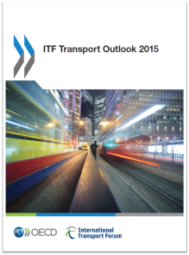
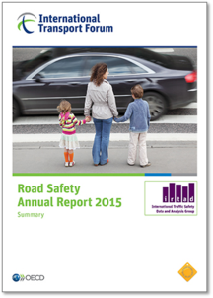
ITF: Think Tank
Evidence-based research and analysis
Data, statistics and modelling
Identification of best-practice policies
Notes:
Roundtables
Working groups
Case specific policy analysis (on request of governments and other public entities, international organizations…)
CPB reports

Slide 4
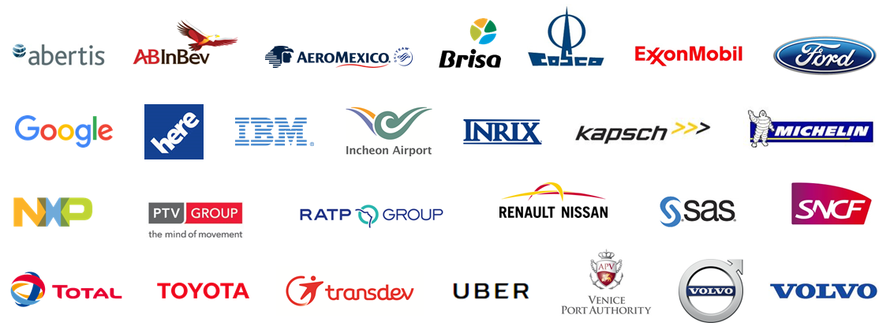
Corporate Partnership Board (CPB)
Essential instrument to integrate corporate perspectives in policy analysis; emerging topics
All modes of transport and associated sectors; balanced geographical representation

Slide 5
Safety and Security
Security: measures to address terrorist attacks, crimes committed on the premises of transport operators, theft of cargo in transit, or cyber security, piracy on the high seas…
Rail Security Workshop
Railway Safety and Security session (Hall 3, 12:30 to 14:00)
Notes:
Safe, secure and resilient transport systems
Refer to international conventions on transport safety and efforts to foster more secure transport systems
Support initiative to ensure that transport systems are more resilient to natural disasters, accidents, malicious acts…
Highlight importance of coordinated action between governments and business
Support international measures and continued cooperation: maritime transport (IMO) and aviation (ICAO)
Innovation and new technologies
Encourage international partnerships and collaboration, optimising resources and sharing good practice
Foster international standards for new technologies alongside agreed safety and privacy protocols
Promote measures to ensure cyber security and data protection
Foster regulatory framework for automated and autonomous driving to ensure safe and secure use of innovative technologies
Recognise that innovative solutions may require adjustment in regulatory and fiscal frameworks to ensure safety and security

Slide 6
Thank you

