Slide 1



Risk analysis

Slide 2
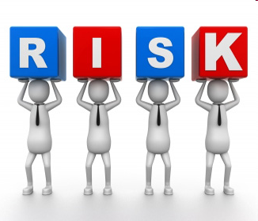
Risk analysis means a process consisting
of three interconnected components:
  Risk assesment
  Risk managment
  Risk communication

Slide 3

Risk Analysis system
Risk assesment means a scientifically based process consisting of four steps: hazard (agent) identificacion, hazard characterisation, exposure assesment and risk characterisation.
Risk management means the process for selecting appropriate prevention and control options.
Risk communication means the interactive exchange of information and opinions through the risk analysis process.

Slide 4
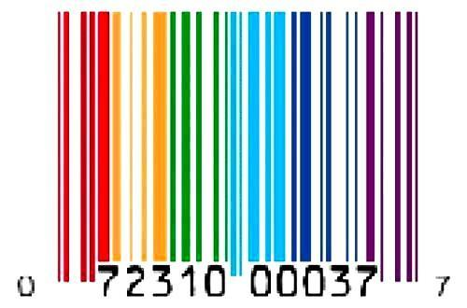
Operators Responsibilities
  Food business operators shall ensure at all stages of production, processing and distribution that foods satisfy the requirements of food law.
  Food operators shall be able to identify any person from whom the have been supplied with food or any substance intended to be incorported into a food.

Slide 5
Traceability System
Traceability means the ability to trace and follow a food, feed, food producing animal or substance intended to be or expected to be incorporated into a food or feed, throug all stages of production, processing and distribution.
http://ec.europa.eu/food/food/foodlaw/traceability/factsheet_trace_2007_en.pdf

Slide 6

Why is important Traceability?
The identification of the origin of food ingredients and food sources is of prime importance for the protection of consumers.
Traceability facilitates the withdrawal of unsafe food.
Identify and document information on product “one step forward and one step back” in the food chain.

Slide 7
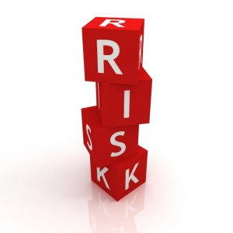
Risk Assesment
Clasification of traders acording to risk factors
Company (Type, size, activity, quality department)
Produce (SMS /GMS)
Campaing (Volumen, evolution)
Traders fall into red, amber or green categories or
“Exempted trader” (Auditing system)
Programme of visits
Different visit frequencies
Inspectors give priority to high risk traders
Inspection records entered directly into SOIVRE database system
Problems found on visits to traders are taken into account in trader clasification.
Surveillance based on signal, dissapointing results.

Slide 8
The risk analysis: a double risk classification
The criteria considered to assess risk are:
(initial check frequencies)
  Position of traders in the marketing chain.
  Efficiency of the self checking systems.
  Size of the traders (volume marketed).
(final check frequencies)
  Findings made during previous checks.
  Exceptional circumstances.
Notes:
Other parameters (the nature of the product, production conditions,…

Slide 9
The risk analysis: the size classification
Traders are classified in three groups, based on the annual volume of commercialized products (estimated marketing capacity):
Less than 3.000 tm/campaign or per year.
Between 3.000 and 25.000 tm/campaign or per year.
More than 25.000 tm/campaign or per year (higher level of risk).

Slide 10
The risk analysis: self checking system classification
The existence and efficiency of a self checking system determines four levels of risk:
Type A. Minimum risk. (Approved traders)
Type B. Unapproved traders with quality control department which permits documentary auditing.
Type C. Unapproved traders with an appointed head of quality control.
Type D. Other traders: unapproved or non registered traders, or traders without an appointed head of quality control (high risk).

Slide 11
The risk analysis: risk level and check frequency
Five levels of risk determining five frequencies of checks:
Minimum, 1 visit per year.
Greatly reduced, 1 visit every 6 months.
Reduced, 1 visit every 3 months.
Medium, 1 visit per month.
High, 1 visit every 15 days.
Notes:
For the assignment of check frequencies, we have taken into account the experience and the statistic data of the official conformity checks that we have carried out in previous years. This includes factors such as the evaluation carried out of the system requirements to implant, and the personal, technical and material capabilities of the official inspection bodies.

Slide 12
The risk analysis: changes in the initial frequency
  Internal factors: trader’s particular record (situations that only affect a single trader).
  External factors: specific situations which affect to one or more products and/or specific markets.

Slide 13
The risk analysis: changes in the initial frequency
  External factors that affect the produce:
Initial or closing periods of the campaign
Specific problems related to a product or to a specific origin (pesticides, negative publicity campaigns, etc.)
Adverse climatic circumstances in origin (frosts, intense rains, heat waves, etc.)
Pest and diseases which seriously affect the quality
Serious problems at the destination markets (oversupplying, decline in consumption, etc.)
Problems with transport and/or distribution (strikes…)
Notes:
Commercial problems or abnormal situations

Slide 14
The risk analysis: changes in the initial frequency
  Internal factors (trader’s particular record):
  If there have been the following findings of NCN,
    2 or more NCN (< than 3000 tm/campaign)
    4 or more NCN (3000 – 25000 tm/campaign)
    6 or more NCN (> than 25000 tm/campaign)
  the trader involved will pass to the check frequency immediately above.
Notes:
These situations fundamentally refer to the results of the official conformity checks carried out with the company (trader’s record), regardless of whether they come from the competent inspection body at origin or in the destination markets, whether these are national, community or third country markets.
Are excluded to this general rule the following findings of non conformities:
Those which the competent inspection body establishes as non computable, based on the type or degree of the checked defect or deficiency, or to the size or tonnage of the non-conforming lot.
Those checked in the first visit of control derived from the change to a new frequency of control, whatever number of findings of conformity checks are carried out within the same trader.
These exceptions will be applied by the competent inspection body where they consider them appropriate and are not repetitive or fraudulent.

Slide 15
The risk analysis: return to the initial frequency
  The trader will return to the previous initial frequency:
  automatically, when 3 or more conformity checks without negative results have occurred, or
  through a motivated decision by the competent inspection body:
    at an individual or collective level, or
    when the marketing campaign has been concluded.

Slide 16
Conformity controls at export and import level
  The conformity certificate is compulsory for customs clearance, both for import and export from/to third countries.
  But it is not possible to check every consignment for conformity.
  As a general rule, the basic check frequency is:
 | Import | Export
Minimum % of conformity checks (physical) | 80 % | 50 %

Slide 17
Conformity controls at export level
  The initial minimum frequency of physical controls is based on the type of trader according to its self checking quality system:
Minimum % of consignments for conformity checks (physical)
Frequency of visits allocated to the trader | Type A (Approved traders) | Types B, C, D (Unapproved traders)
Minimum Greatly reduced Reduced | 60% | 70%
Medium High | 70% | 100%

Slide 18
Conformity controls at export level
  The final frequency of physical controls is based on the type of product:
Minimum % of consignments for conformity checks (physical)
 | High perishable | Perishable | Less perishable
Products with specific marketing standard | 90% | 70% | 60%
Products with general marketing standard | 80% | 60% | 50%

Slide 19
Conformity controls at import level
  The criteria to asses the risk include the country of origin and the type of product.
  Regarding the country of origin, the existence of a conformity certificate issued by a third country where the conformity checks have been approved by the Commission (art. 15), is a factor that reduces the risk of non conformity.
 | Approved country + certificate | Other
Minimum % of conformity checks (physical) | 80 % | 100 %

Slide 20
Conformity controls at import level
  The final frequency of physical controls is based on the type of product:
Minimum % of consignments for conformity checks (physical)
 | High perishable | Perishable | Less perishable
Products with specific marketing standard | 95% | 85% | 75%
Products with general marketing standard | 85% | 75% | 55%

Slide 21
Approved traders

Slide 22
Implementing Regulation (UE) No 543/2011
The risk analysis: approved traders (art. 12)
To become an approved trader it is necessary to:
have inspection staff who have received appropriate training;
have suitable equipment for preparing and packing produce;
commit themselves to carry out a conformity check on the goods they dispatch and have a register recording all checks carried out.

Slide 23
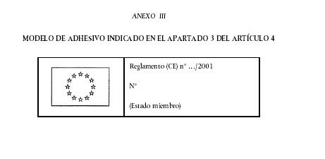
Implementing Regulation (UE) No 543/2011
The risk analysis: approved traders (art. 12)
Traders providing special guarantees on conformity to marketing standards are classified in the lowest risk category.
Approved traders may use the specimen in Annex II in the labelling of each package at the stage of dispatch.

Slide 24

RISK ANALYSIS
Software support tools

Slide 25
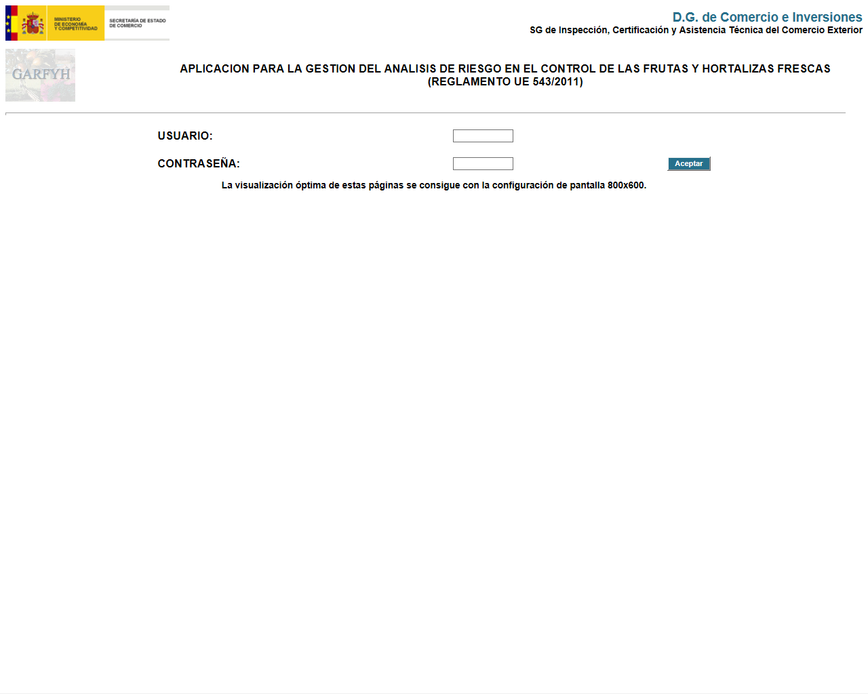
Software support tools
GARFYH: the Risk Analysis application

Slide 26
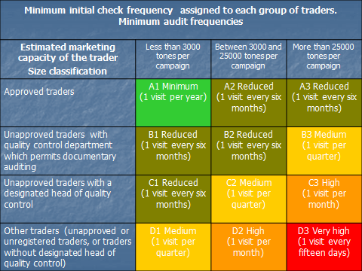
Implementing Regulation (UE) No 543/2011
The risk analysis: risk level and frequency of checks
Notes:
The risk level and frequency checks may summed ip in a table like this where the green colour stands for the lowest frequency (A1- 1 visit per year to approved trader with less htan 3000 tons per campaign) and the highest would correspond to traders without designated quality control and more than 25000 tons per campaign (D3 - 1 visit every 15 days)

Slide 27

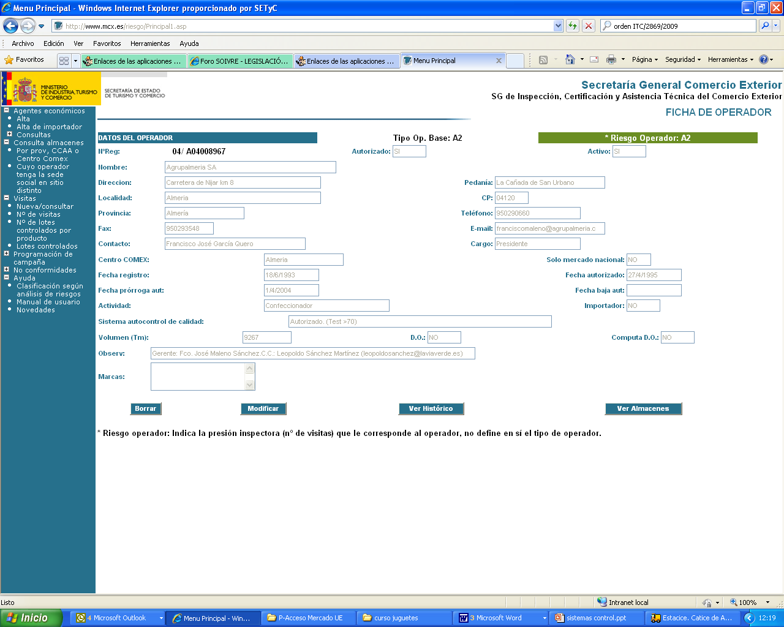

Slide 28
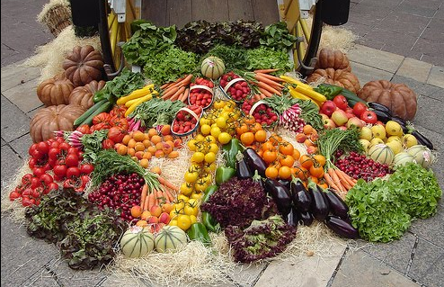
Thank you for your attention.
SOIVRE

