Slide 1
Fresh fruit and vegetable exports from Greece: solutions
Purpose and scope

Slide 2
Time to export
© 2014 The World Bank Group, All Rights Reserved.
Time is recorded in calendar days. The time calculation for a procedure starts from the moment it is initiated and runs until it is completed. If a procedure can be accelerated for an additional cost, the fastest legal procedure is chosen. It is assumed that neither the exporter nor the importer wastes time and that each commits to completing each remaining procedure without delay. Procedures that can be completed in parallel are measured as simultaneous. The waiting time between procedures--for example, during unloading of the cargo--is included in the measure.

Slide 3
Documents to export
© 2014 The World Bank Group, All Rights Reserved.
All documents required per shipment to export goods are recorded. It is assumed that the contract has already been agreed upon and signed by both parties. Documents required for clearance by government ministries, customs authorities, port and container terminal authorities, health and technical control agencies and banks are taken into account. Since payment is by letter of credit, all documents required by banks for the issuance or securing of a letter of credit are also taken into account. Documents that are renewed annually and that do not require renewal per shipment (for example, an annual tax clearance certificate) are not included.

Slide 4
Ease of doing business index
© 2014 The World Bank Group, All Rights Reserved.
Ease of doing business ranks economies from 1 to 189, with first place being the best. A high ranking (a low numerical rank) means that the regulatory environment is conducive to business operation. The index averages the country's percentile rankings on 10 topics covered in the World Bank's Doing Business. The ranking on each topic is the simple average of the percentile rankings on its component indicators.

Slide 5
Production vs value

Slide 6
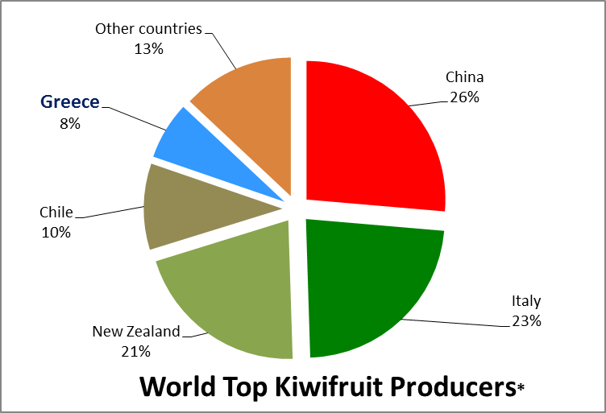
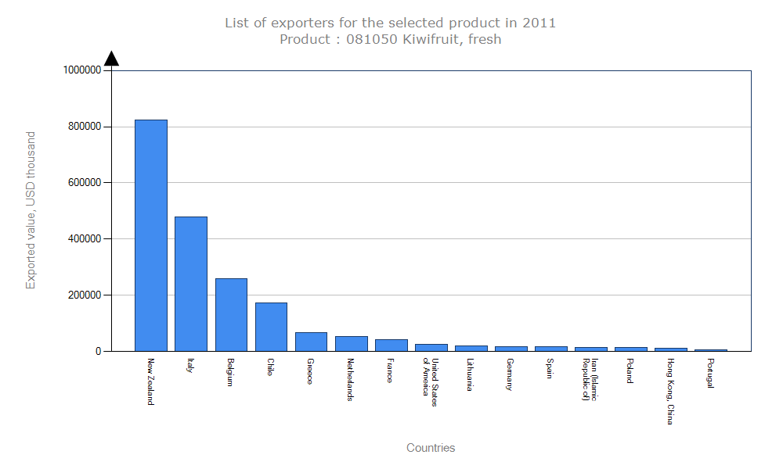
Production vs value
3%?

Slide 7
Key performance indicators
Reduction of time to export
Reduction of export costs
Predictability (reduction of variance in cost and time)

Slide 8
LivingLab

Slide 9
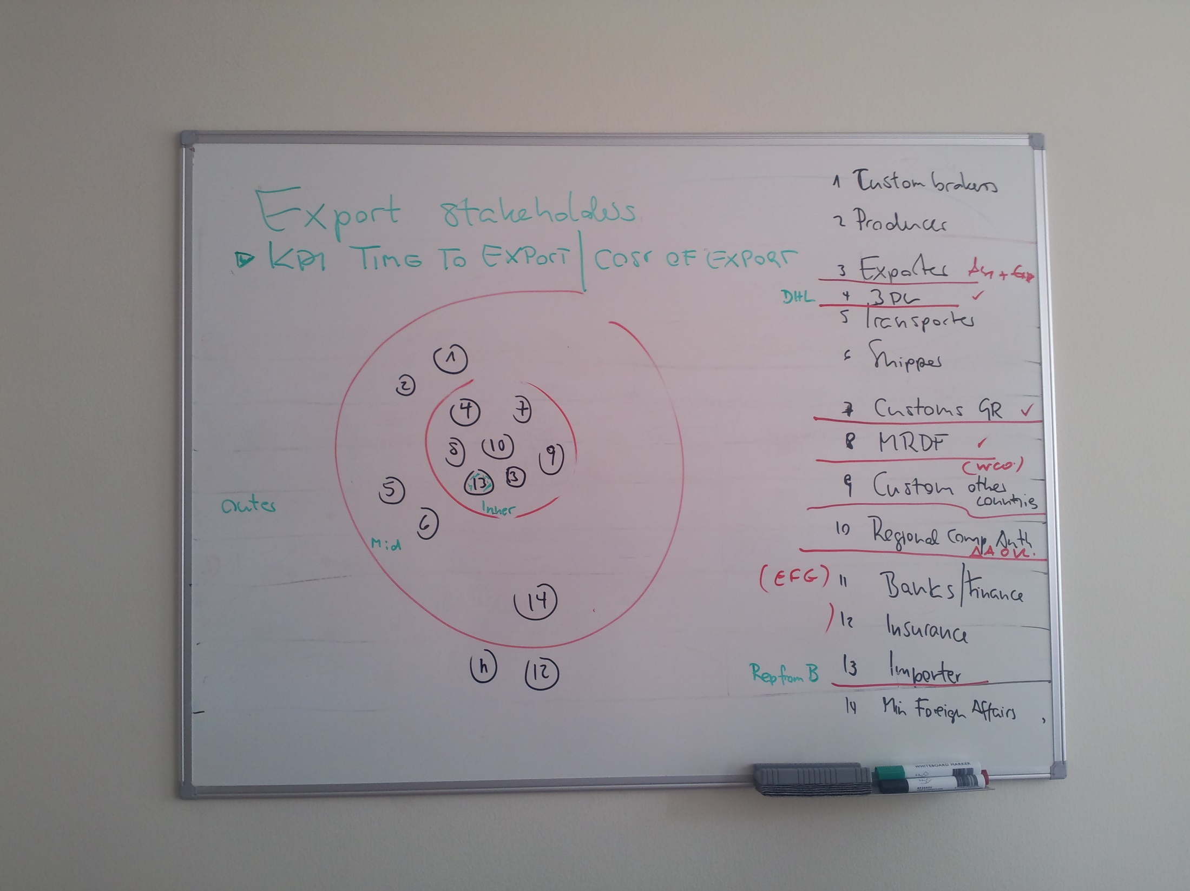
Stakeholders
Exporters and/or exporter association(s)
Importer representatives
Third party logistics providers
Directorate of phytosanitary controls
Directorate of quality control
DAOK (local competent authority)
Directorate of Customs
UN ECE and TFGR

Slide 10
Workshops
Fresh fruit and vegetable exports from Greece: challenges
Identification of hotspots
and potential solutions
International benchmarking
How do others cope?
Fresh fruit and vegetable exports from Greece: solutions
12th June 2014
Policy makers
Administration
Private sector

Slide 11
Programme of the day
Time | Subject
09:00-09:15 | Welcome - Representative UN ECE Presentation of participants
09:15-09:30 | Purpose and scope of the meeting Dr Heiner Lehr
09:30-10:00 | Summary of initial workshop and identified challenges Dr Heiner Lehr
10:00-11:00 | International good practice as benchmarks for Greece Part I EXPORT PROMOTION BOARDS COOPERATIVES as models to get economies of scale Dr Heiner Lehr
11:00-11:30 | Coffee break
11:30-13:00 | International good practice as benchmarks for Greece Part II EXTENSION SERVICES ELECTRONIC SUPPY CHAIN TRANSPORT AUTOMATION AND SCHEDULING OF INSPECTIONS Dr Heiner Lehr
14:00-14:30 | Light Lunch
14:30-16:00 | Discussion of solutions Dr Heiner Lehr
16:00-16:20 | The smarter food vision Dr Heiner Lehr
16:20 | Closure Representative UN ECE

Slide 12
Thank you for your attention!
Dr Heiner Lehr
Syntesa Partners & Associates
heiner@syntesa.eu

